Slide 1



Migrating Monoliths to Microservices Challenges and Patterns Audience: Architects

Slide 2
Agenda
Migrating Monoliths to Microservices
Microservices – History, Driving Forces, and Definition
Microservices Patterns
DevOps
Reactive Microservices
1
5
9
13
AD
All
D
AD
A
Microservices Prerequisites
Integration
Securing Microservices
Testing
2
6
10
14
AD
AD
A
D
A
A
Spring Boot
Migrating Monoliths to Microservices
Domain Driven Design Testing
Scaling Microservices
3
7
11
15
AD
D
A
A
A
Case Study
Cloud
UI
Microservices Anti-Patterns
4
8
12
16
AD
AD
All
All
A
A
Legend: All Developer Advanced Developer Architect
All
D
AD
A

Slide 3

Objectives
Migrating Monoliths to Microservices
At the end of this module, you should be able to:
Understand the various situations that lead to the transition from Monoliths to Microservices
Recognize the factors that lead to service decomposition
Identify the criteria involved to tackle the database while transitioning to Microservices
Understand the transactions, reporting practices, UI, and event-driven patterns that are involved in the transition

Slide 4
Topic
Migrating Monoliths to Microservices
Introduction
Service Decomposition
Tackling Monolithic Database
Transactions
Reporting
UI- ‘FrontEnd’
Event-driven Patterns

Slide 5
<Need a title here>
To SME: We need a title for this section.

Slide 6
Problem Definition: Discussion Context
Migrating Monoliths to Microservices
Legacy Codebases, which have evolved organically
Monolithic applications with no clear domain and module boundaries
Databases supporting Monolithic services are monolithic as well.
Monolithic services and database compliment each other, so application grows with more and more footprint of this pattern.
The team and organization structure reflect this monolith. Big teams that spend time in co-ordination and waiting on other resources
The deployment and release cycle follows a monolith, which consists of infrequent releases and large maintenance windows.

Slide 7
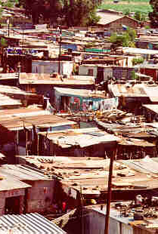
Problem Definition: Discussion Context (Continued)
Migrating Monoliths to Microservices
When monolith grows over time, it is unmanageable, difficult to understand, and thus a BIG-BALL-OF-MUD with low cohesion and high coupling.
Source: http://www.laputan.org/mud/mud.html#BigBallOfMudn

Slide 8
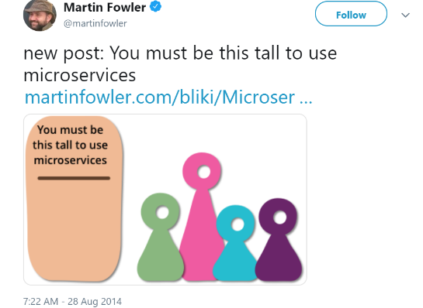

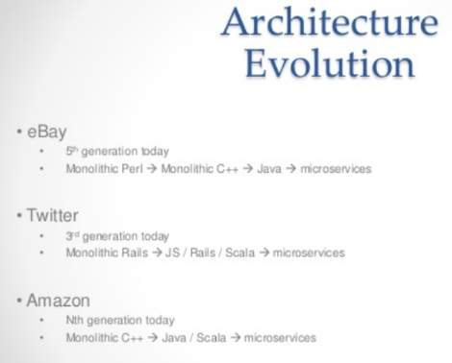
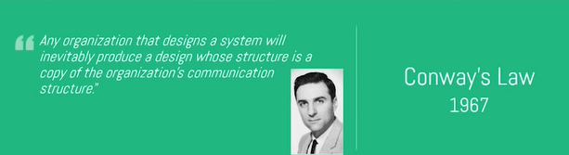
Before starting, few words from the wise!

Slide 9
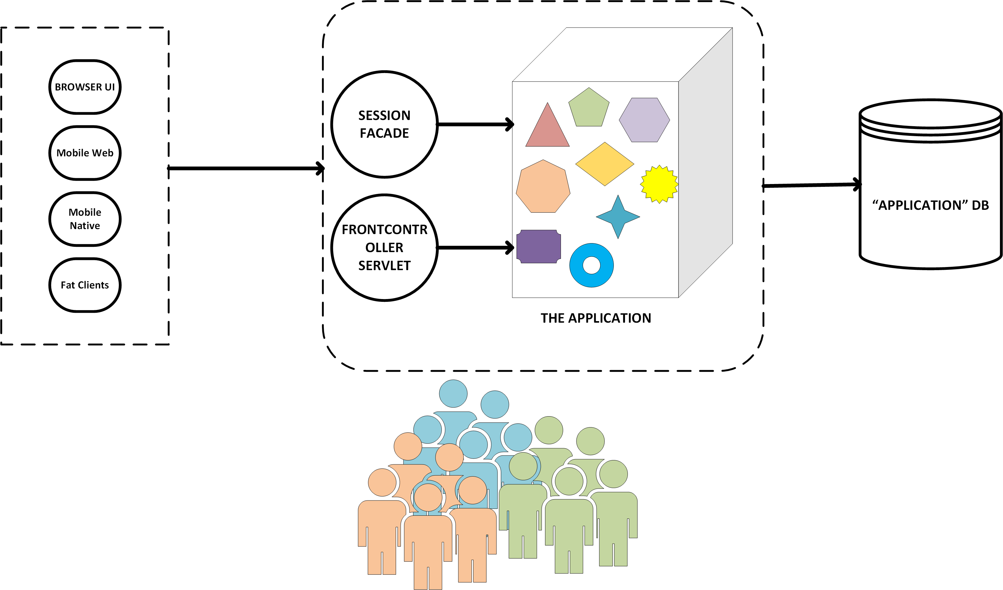
Journey at a Glance: Typical Monolith
Migrating Monoliths to Microservices

Slide 10
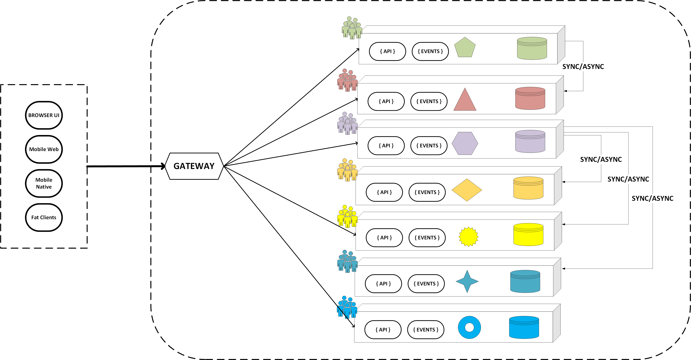
Journey at a Glance: Target
Migrating Monoliths to Microservices

Slide 11
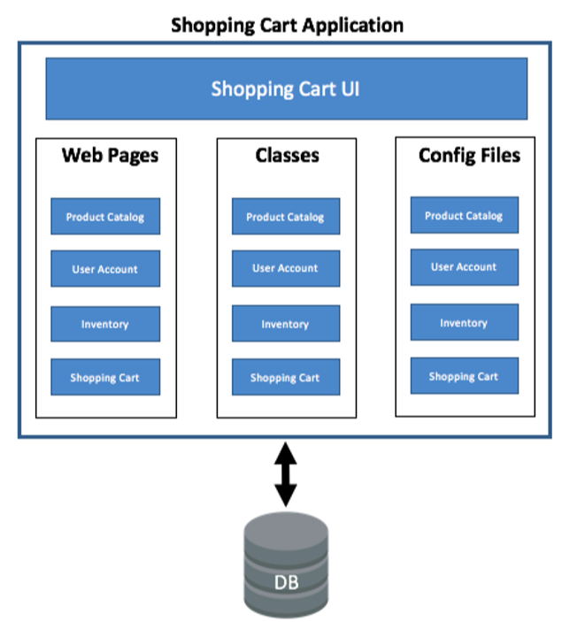
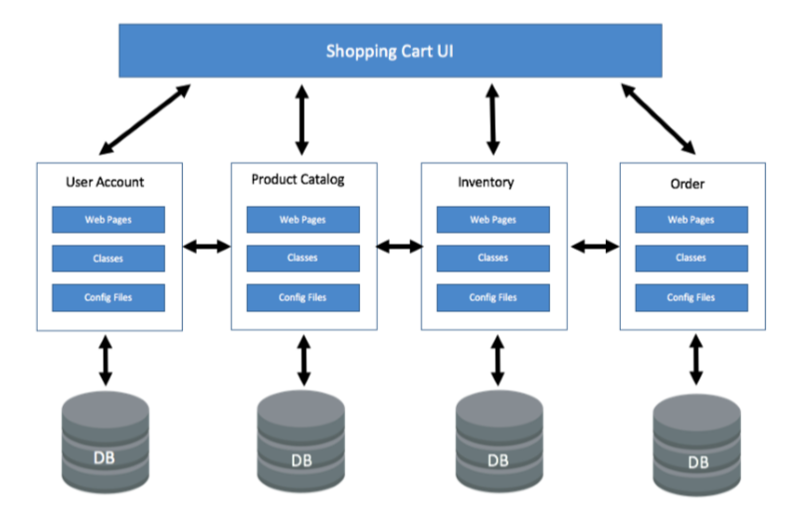
Journey at a Glance: Example
Migrating Monoliths to Microservices

Slide 12
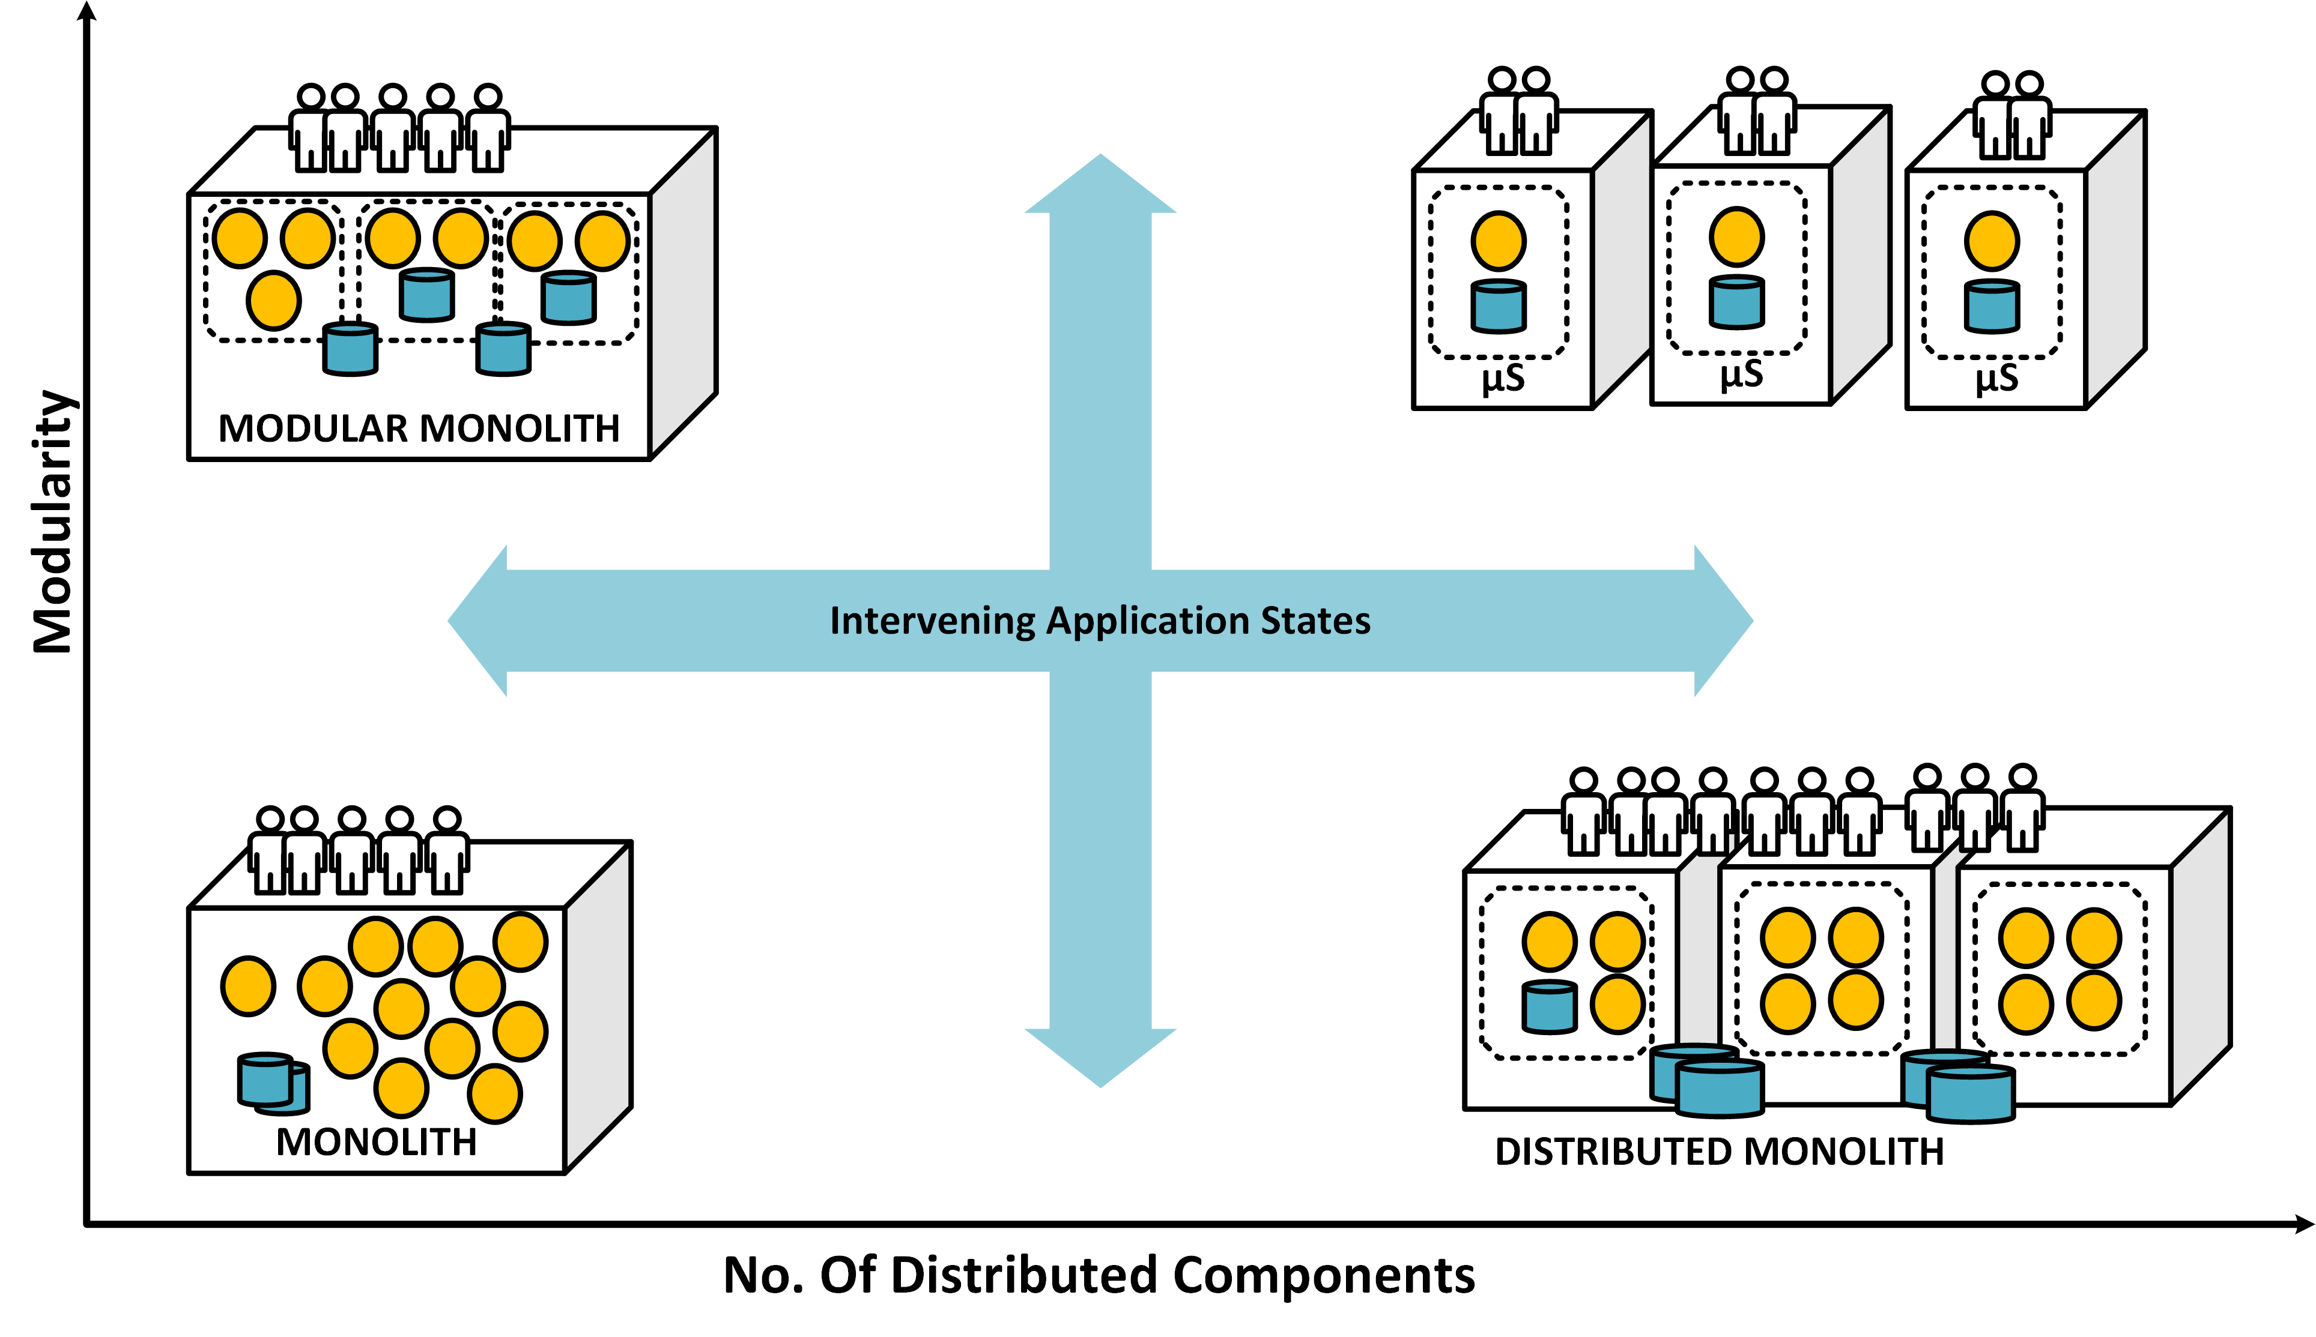
Journey at a Glance: Somewhere in Between

Slide 13
Goals of Microservices Journey
To GA: Need an infographic here.
Independent Development
Independent Deployment
Independent Scalability
Isolated Teams
Eventually Consistent
Fast feature rollout
Greater time-to-market
Faster feature rollout
Least impact on the whole application
Greater time-to-market
Isolated scaling
Focussed scaling
Independent cross-functional teams
Eliminate wasteful coordination meetings
Decentralized governance
Eventually consistent transactions
Eventually consistent Microservices state
Business-driven
Technical separation matches domain separation
Overall separation also matches clear independent stakeholders
Build MVP quickly
Evolutionary Architecture
Architecture evolves as much as possible over time
Design for replacement(not re-use!)
Minimal shared dependencies
Autonomy
Pragmatic

Slide 14
Goals of Microservices Journey (continued)
To GA: Need an infographic here.
Cohesive and Decoupled Services
Self-contained systems
NOT a Distributed Monolith
NOT a system made up of arbitrary sized and tightly-coupled services communicating over network interfaces
Hype-driven
Encapsulate Domain
Should be reflection of domain instead of mere entity CRUDs
Slice across all Layers
Services and UI should be treated as a Microservice
Micro front-ends
Isolate Everything
No front-end Monoliths
Time | Space | State | Failure | Teams | Services | Deployment | Development | Delivery | Scaling | Testing | Hardware
High Observability
Logging
Monitoring
Tracing

Slide 15
Service Decomposition: Which services first?
Migrating Monoliths to Microservices
Team Structure
Fast Changing Services
Services that have large pace of change
Services with Major Business Value
Services that form the core focus of
Database
This is the most complex dependency to solve.
Services that would mean clean separation of database are golden and should be found early.
Other Factors
Data Security (GDPR, HIPPA, and so on)
Monitoring and observability need
Canary type requirement
Simplicity
Simple untangled services are easiest to manage.
Play it safe.
Technical Debt
The services with least entanglement of dependencies with rest of services are easy to separate out.
Test Coverage
Services with good test coverage
should be split early to avoid piling up
changes for a complex migration later.
Splitting teams with support from
dedicated team is easier.
Services with least technical debt are
good candidates since they don’t bring
the debt to Microservices as well.
(preferably automated) would provide
more confidence during migration.
business (read money), should be
enabled for isolated deployment,
Release, and scalability.

Slide 16
‘Strangling’ the Journey!
The journey for a monolith to Microservices doesn’t usually go via rewriting the monolith into Microservices from scratch.
The complexity of the monolith would mean that transformation would take time. But the business change continue during this period as well. So, it is a bit of a moving target.
Here is the problem! How does an organization embark on Microservices journey with speed while not loosing on the most important things for business? That is, to deliver value to its client.
The world doesn’t stop while the migration for monolith to Microservices happens.
Strangler pattern helps manage this journey by allowing for journey to be tackled via small amount of service at a time.
Strangler pattern provides a balance between transformation and change management.
Using the criteria mentioned already, the business needs to come up with the ranked candidate services for migration. While one service is picked up for analysis and re-architecture, rest of the monolith continues to operate.
When part of system is delivered as a Microservice, it co-exists with the rest of monolith. The old monolithic service is thus “STRANGLED”.
This continues till the entire system is chipped-away entirely.
Any new development is done as part of Microservice and not included in the existing monolith.
This allows for safe changes which are easy to rollback in case things go wrong ( and things do go wrong !)

Slide 17
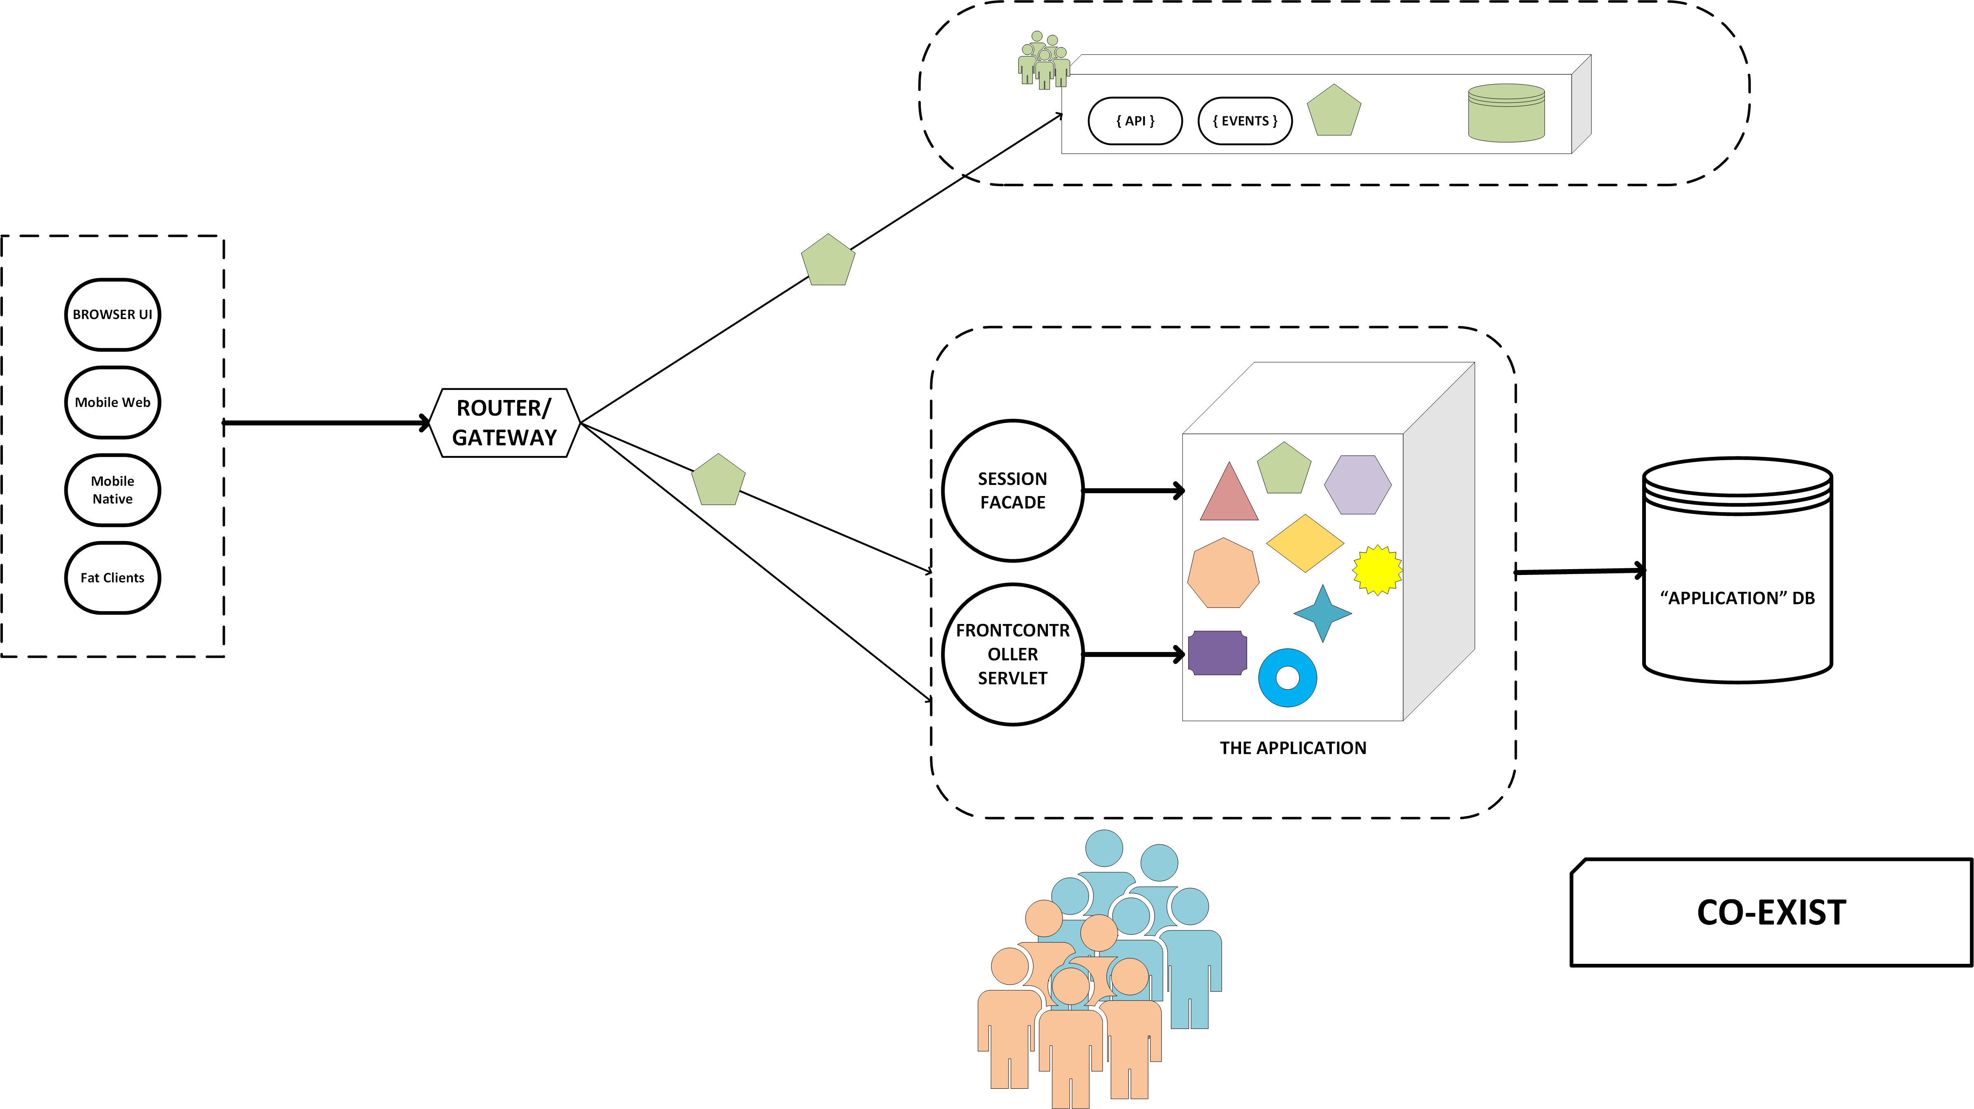
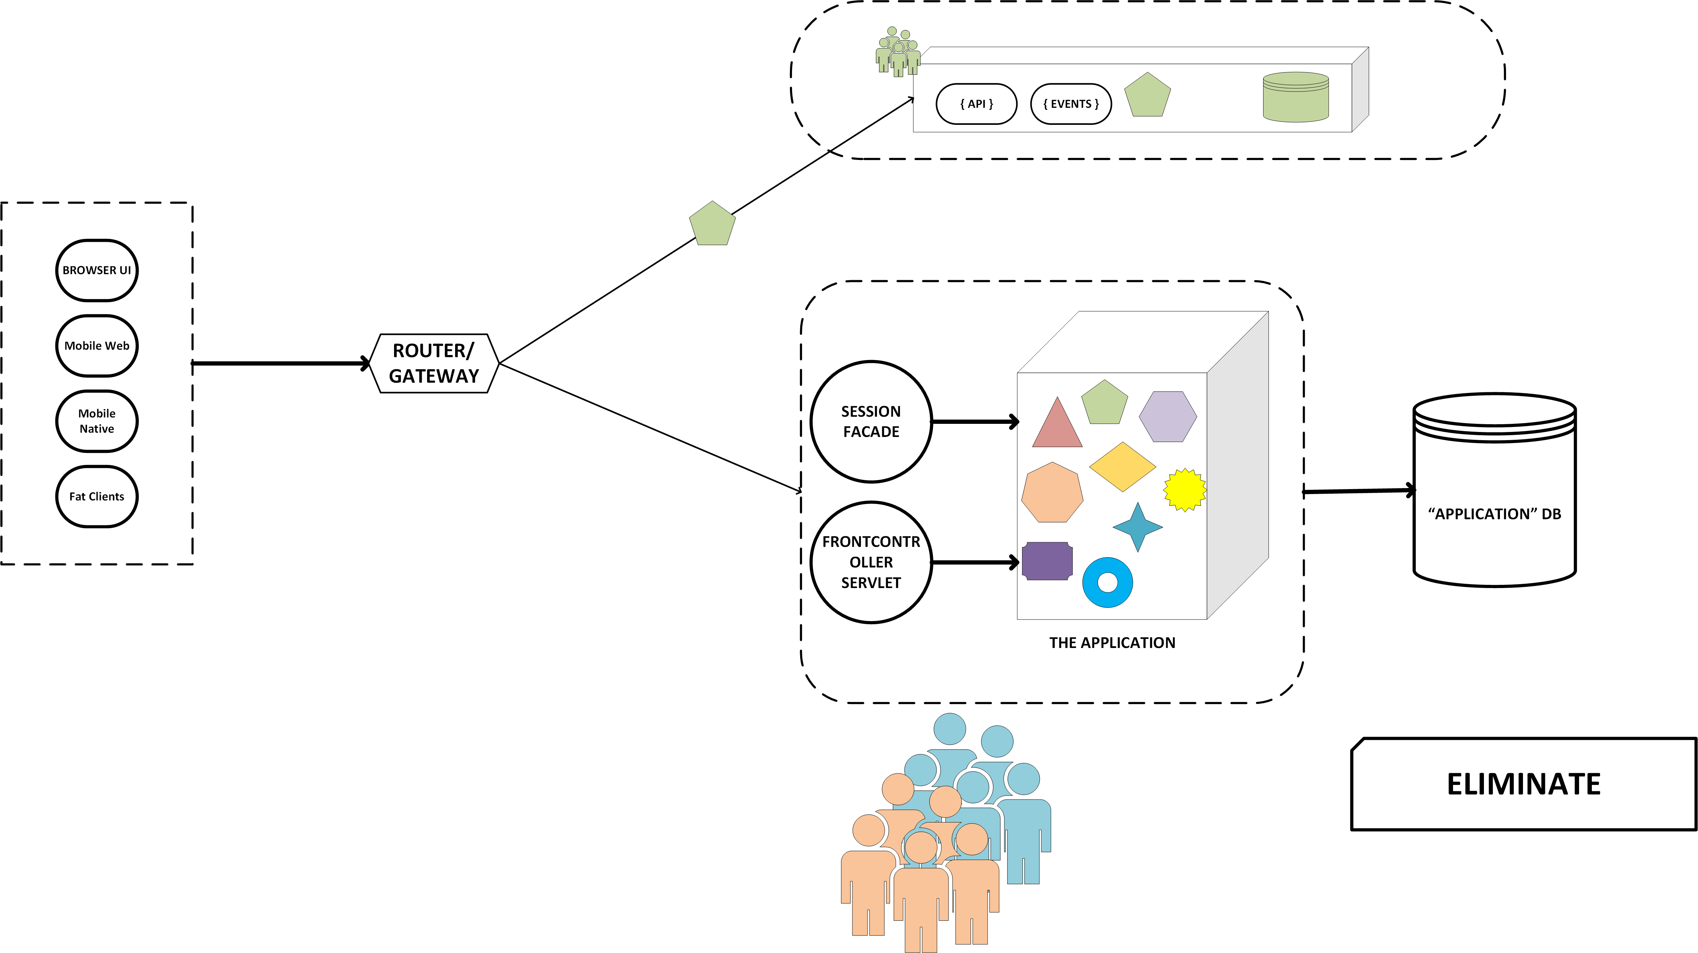
‘Strangling’ the Journey (continued)
For a transitional phase (CO-EXIST phase), both legacy service in monolith and new Microservice would be kept functional and tested in parallel. This allows for faster rollback. Some strategies like Canary or A/B is ideal in this phase. The change in legacy service would have to be done to be looked up via routing component such as gateway or a router.
Finally the legacy service in monolith can be decommissioned entirely.

Slide 18
Service Decomposition

Slide 19
Service Decomposition: Overview
Migrating Monoliths to Microservices
Bounded Contexts – Starting point to modularity
Service Boundaries – Oriented on functions or subdomains
A well designed monolith would have clear module boundaries, expresses via language constructs like java packages. It is easy to reason about service boundaries in such monoliths.
In a monolith where modularity is absent, it is difficult to identify functional boundaries, since everything seems to depend on each other.
It is recommended to get the module and service boundaries right, even if it is for a limited set of services.
The size of Microservices is not a factor of lines of code. It is on the responsibility and cohesiveness for a single unique business function.

Slide 20
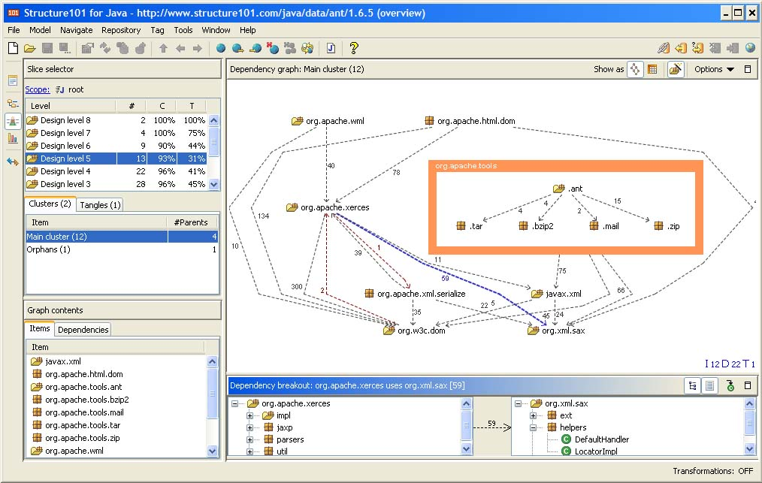
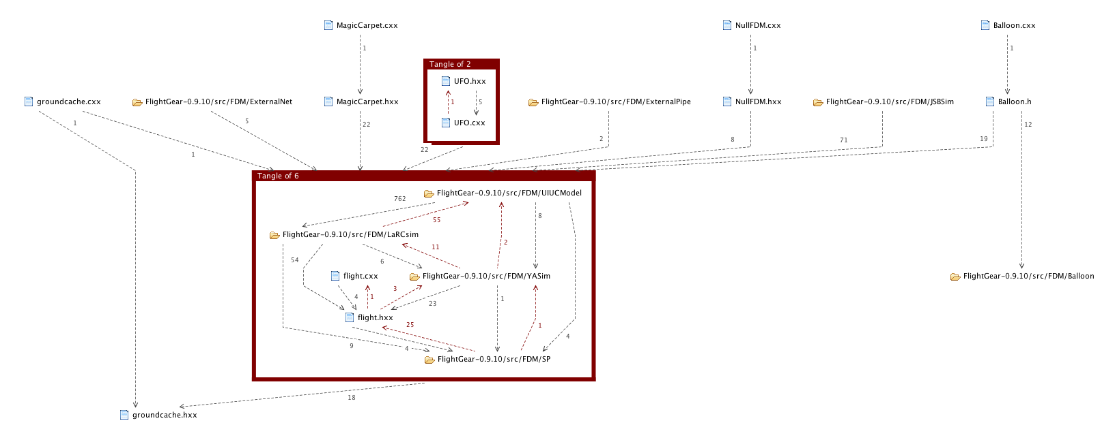
Service Decomposition: Analysing Existing Codebase
Analyse the existing code base by using dependency analysis tools. For example AltovaMissionKit, Structure 101, and so on.
If dependencies exist across potential bounded contexts, then the dependency needs to be refactored.
The process could take days, weeks, or even months, depending on the scale of monolith.
For large monoliths, it is recommended NOT to go ‘big-bang’ and attempt to migrate all services. An incremental approach is better controlled.

Slide 21
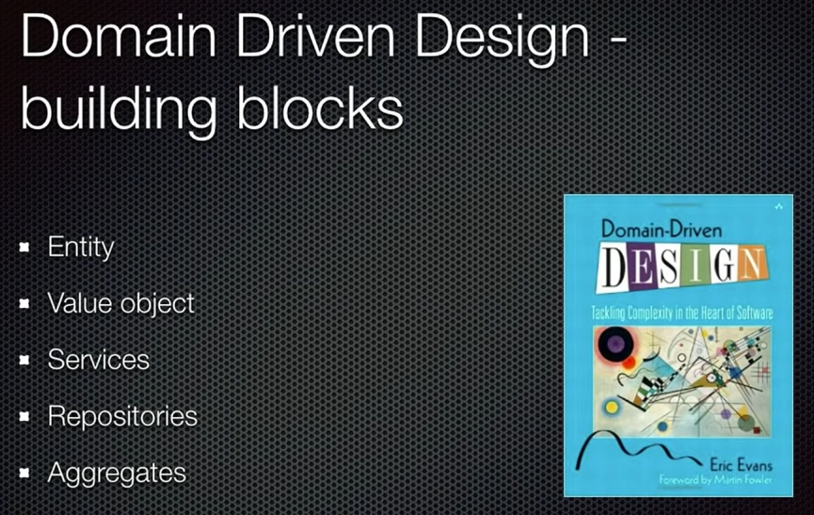
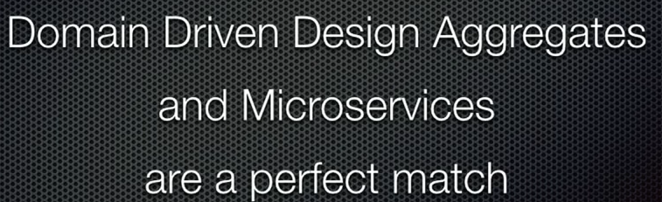
Microservices: DDD Way
DDD-Conventional
Event First DD (Event Driven)
Event Sourcing
CQRS
Event Notifications
Event Carried State

Slide 22
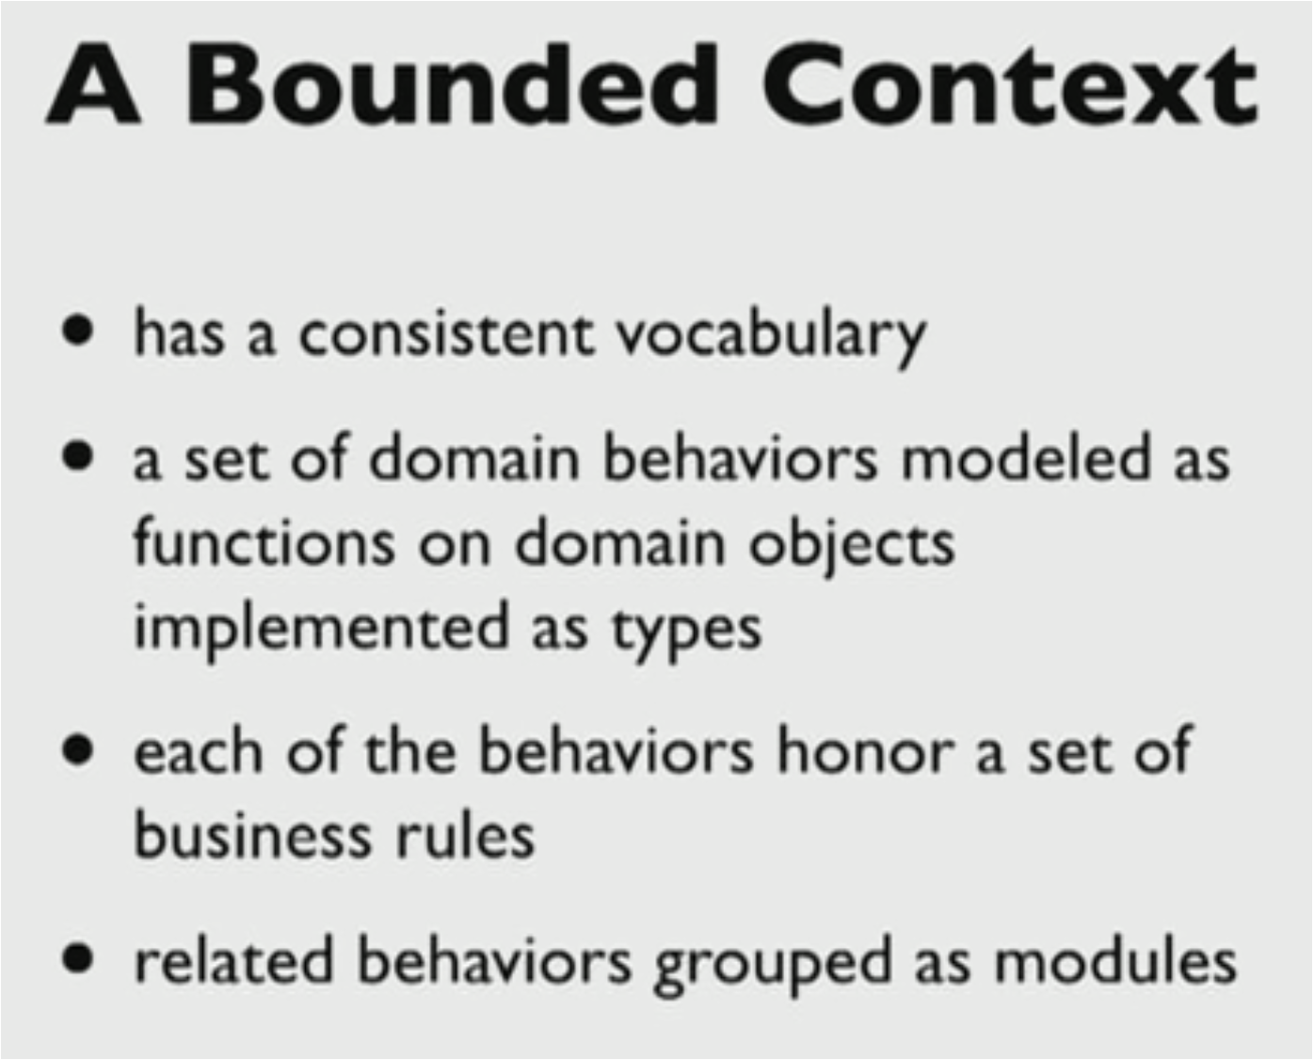
Microservices: DDD Way (continued)

Slide 23
Tackling Monolithic Database

Slide 24
Migrating Monolithic Database for Microservices
Migrating Monoliths to Microservices
Migrating monolithic database is COMPLEX.
Database migration in turn impacts the services migration.
It is easy to make database as a source of integration between services.
ORM technologies have coupled entities in a monolith into a tightly coupled database structure as well.
The coupling between services may be scattered across module boundaries in a monolith. This could be for either reads or writes.
Like services, tackling a focussed part of monolithic database for separation is recommended over a “big bang”.
Splitting the schemas within the monolith first and refactoring the services within monolith first, provides the ability to assess the split and rollback, if needed. The impact of increased number of database calls and service dependencies can be analysed properly with this approach.

Slide 25
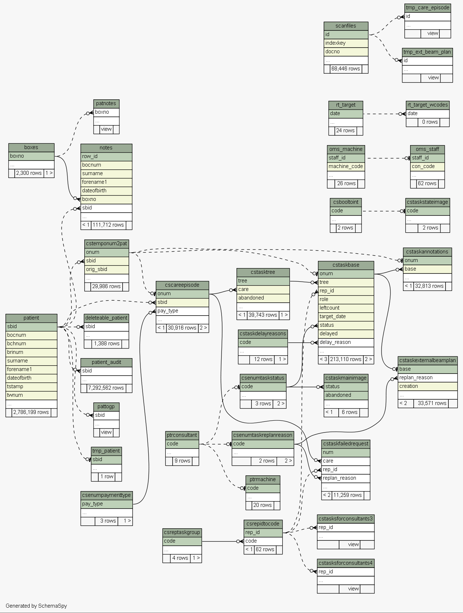
Migrating Monolithic Database: Analyse Database Mapping
As part of service decomposition into functional/bounded contexts, there is already some insight on how the Microservices boundaries would look like.
Using the same service contexts, the database usage needs to be analysed and to map out the tables/database objects used by and across services.
And then, to find ways and patterns to cut the database dependency across the services using some patterns.
The database level relationship, constraints, and dependencies should be analysed via tools such as SchemaSpy (every database provides enough tools to analyse the database schemas).
Finally, mappings would exist that depict the following:
Target service boundaries
Database usage by the bounded services
Database level constraints across database objects
This lays the groundwork to create single database per Microservice (could involve multiple iterations of service and DB design)
This mapping helps understand the coupling between tables that span across potential Microservices boundaries.
While the patterns discussed in this presentation assume a relational database, similar problems and patterns would exist in a NoSQL DBs as well, if a monolith happens to be based on one.

Slide 26
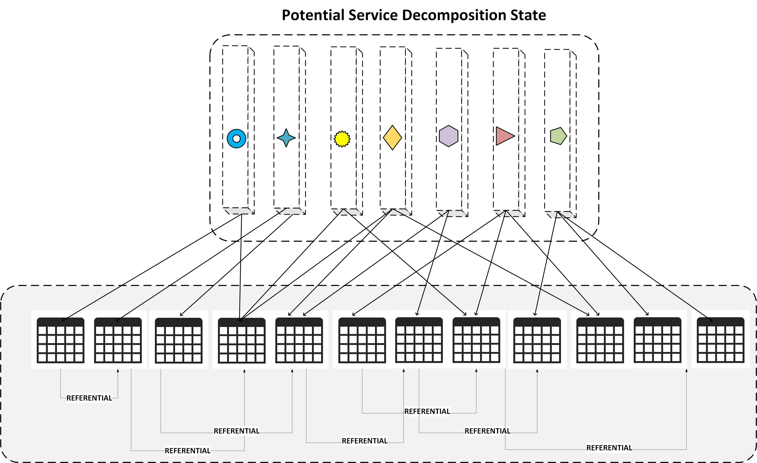
Iterative DB Mapping Stage

Slide 27
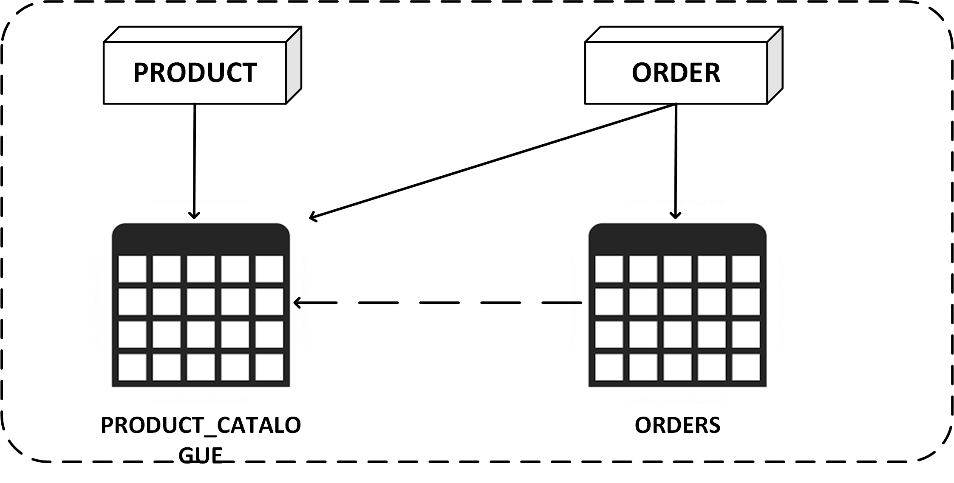
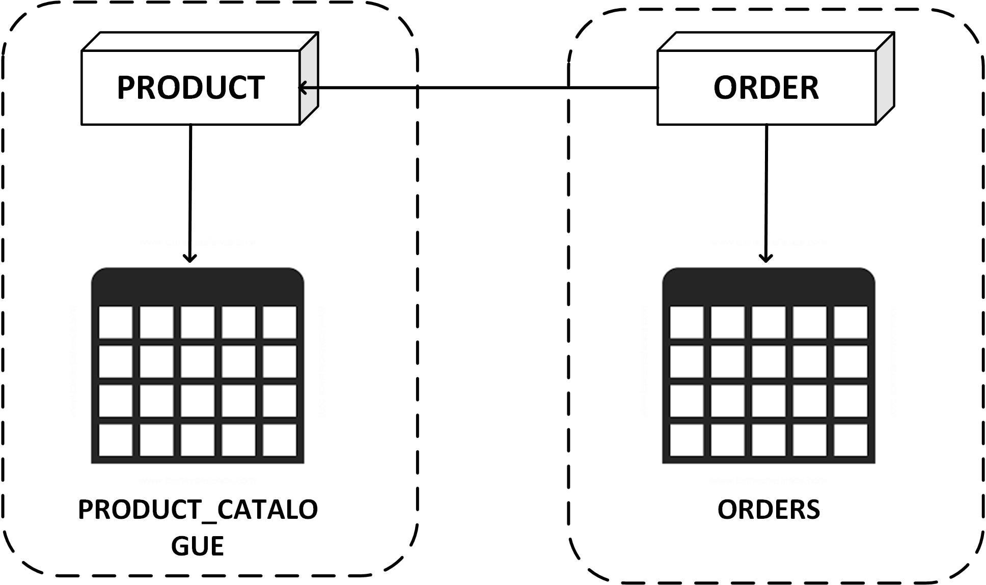
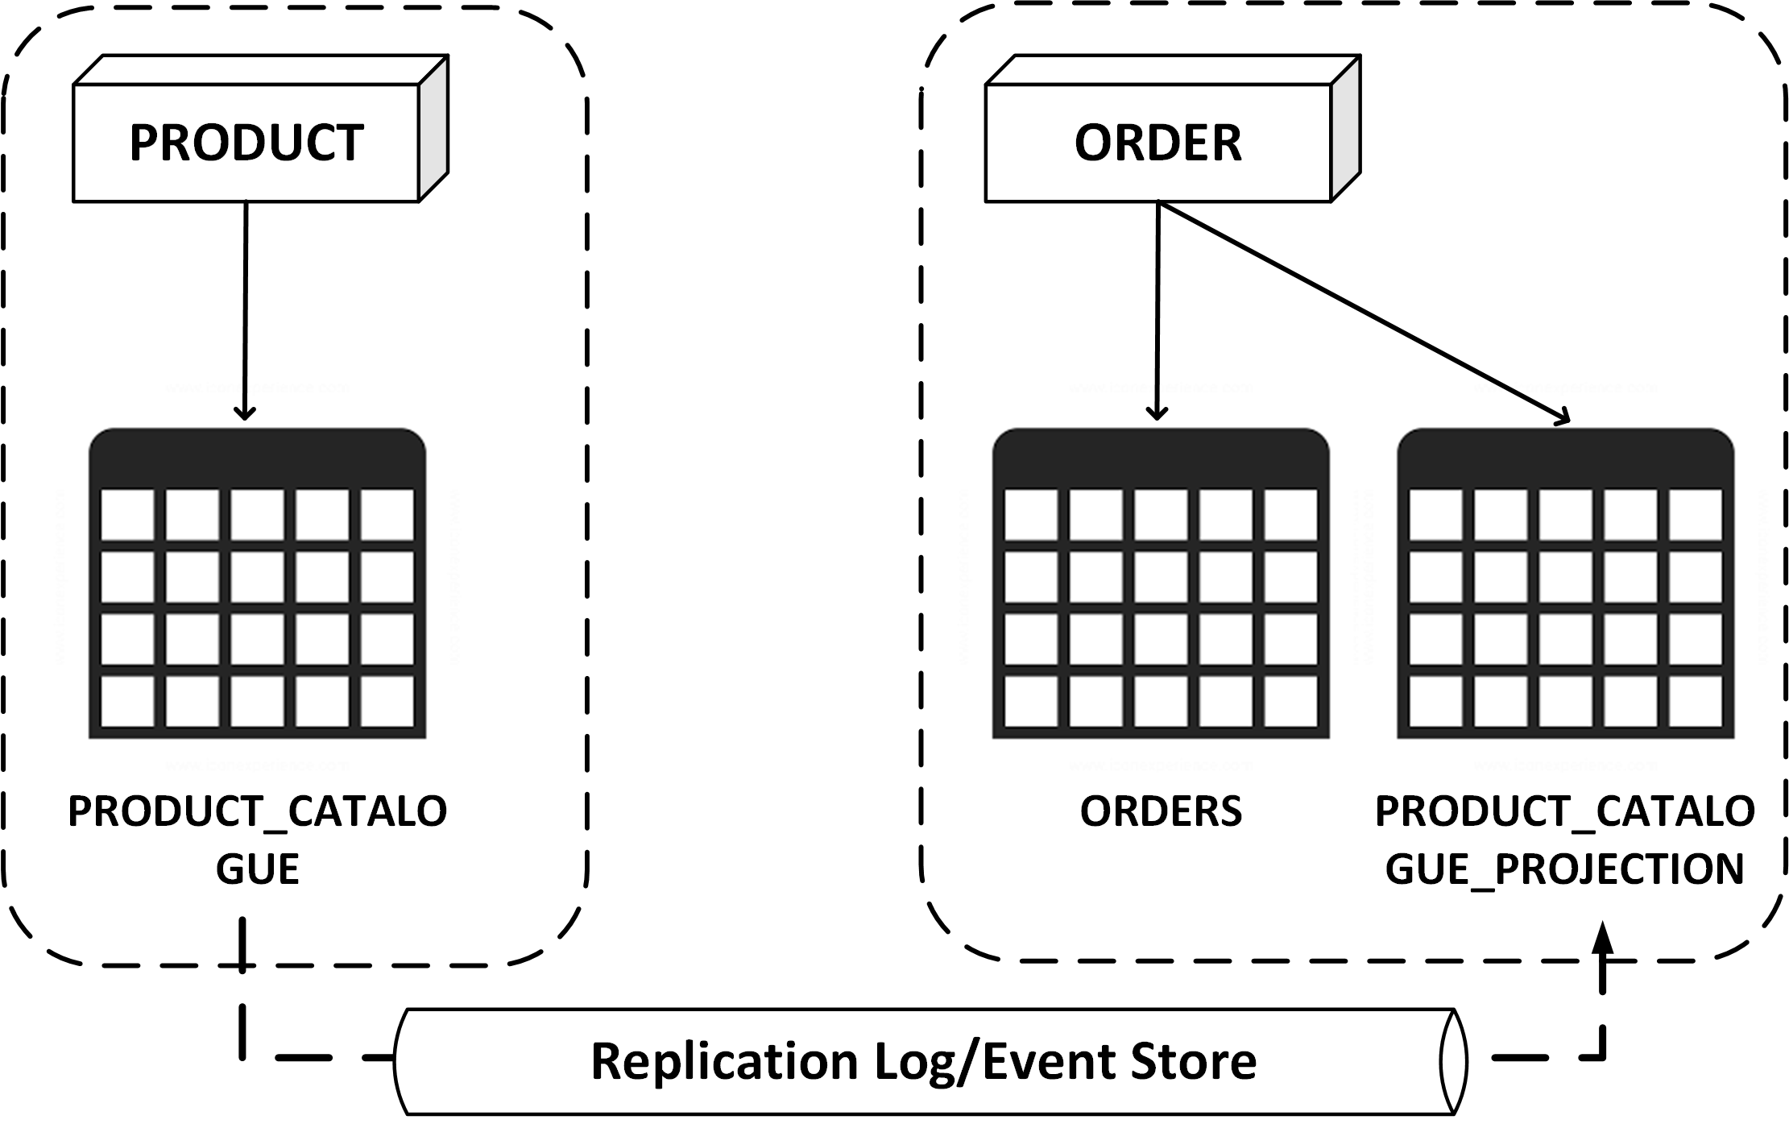
Iterative DB Mapping Stage (continued)
In this pattern, a service accesses tables that belong to a separate service context. The service uses JOINS between its own table(s) and the other table(s) to retrieve data.
When database level relationship is gone, consistency between services is a domain level concern that should be considered as a business problem.
OPTION 1: Since two services are separate, the most obvious way is to expose API in the referred service that exposes data to the calling service. The joins in this case would be in memory.
This has obvious performance issues; but, can work in simple cases where size of data is limited. The impact is additional network and a database call.
OPTION 2: Build a projection of data in the dependent service via either a event-notification, CDC, or any other data pump patterns.
The data would be eventually consistent.
Enable more cohesive service.
The projection is read-only and can be rebuilt anytime.

Slide 28
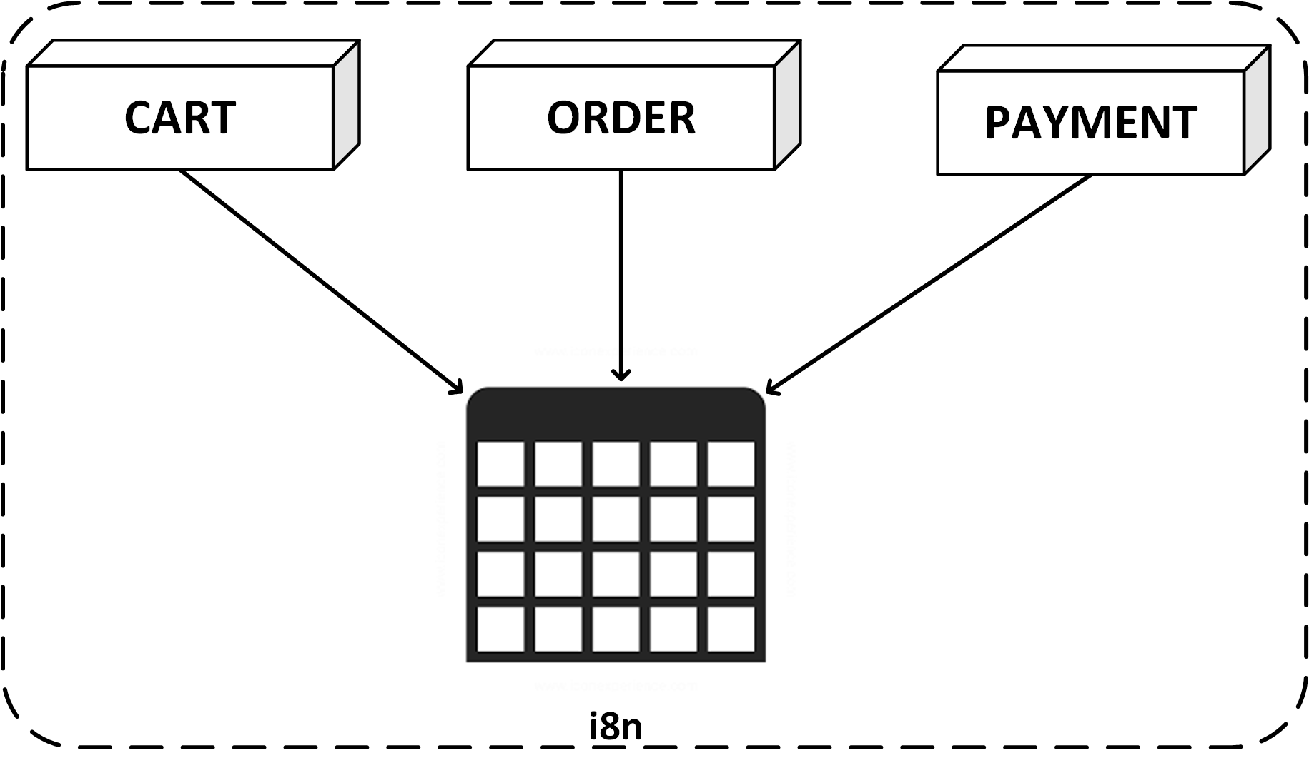
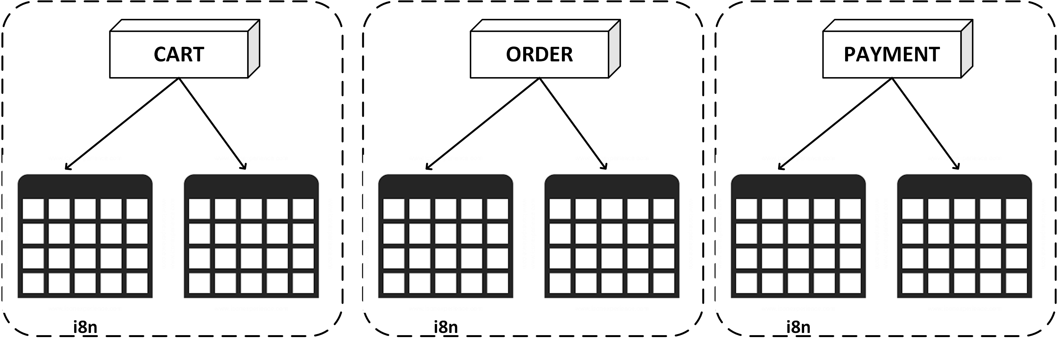
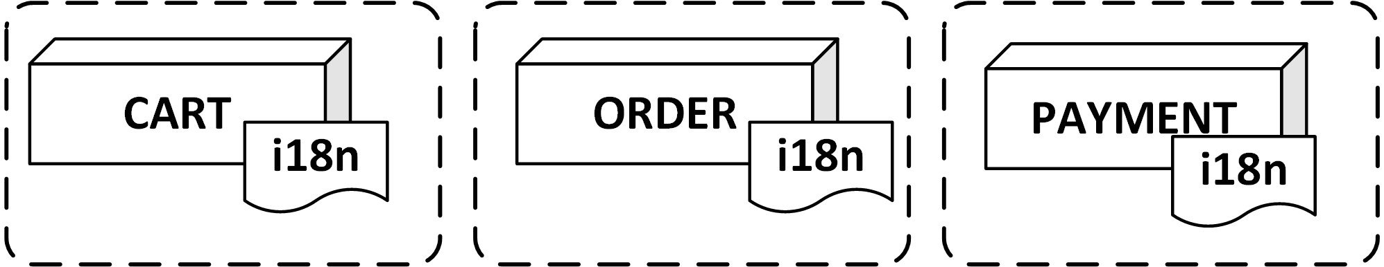
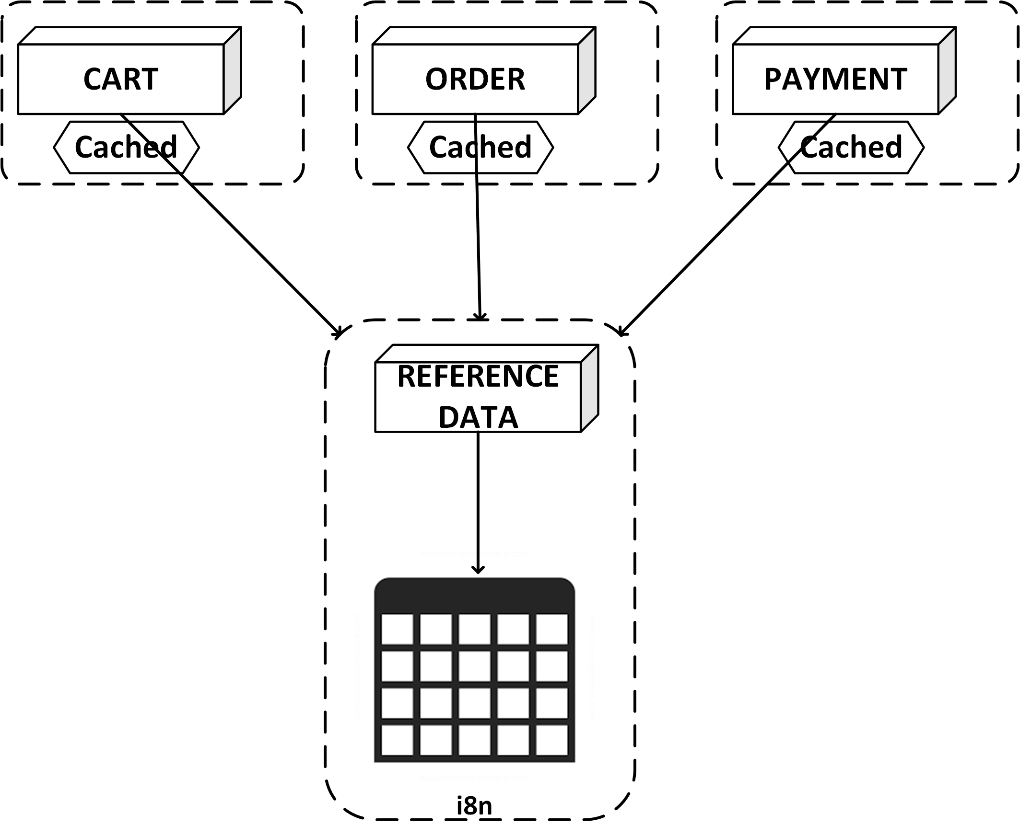
Pattern: Shared Reference, Static Data
Static data like codes, i18n, formats, and so on, that are slow to change, but are used either as a JOIN with existing entities or as a lookup value for UI. The static data specific to each service would obviously go to individual service DB. Application-wide static data needs to be addressed.
OPTION 1: Duplicate the shared static data across service DBs. This helps to keep some querying consistent. The downside is on data consistency and a universal way to update the same data across all service DBs. If the frequency of this change is very infrequent, then creating redundant copies of the static data may be easier.
OPTION 2: If this static data is DB only for the purpose of easy upgrade (like controlled via DMLs) and doesn’t have any entity significance, then it might be better to inject this data as configuration data for Microservices. In modern Cloud platforms, managing configuration data via config servers, vaults, and key-value stores is easy and can be declaratively included in a Microservices container.
OPTION 3: A static data service that is used on conjunction with caching framework on the client Microservices is effective when the static data also includes some pre-processing as well.

Slide 29
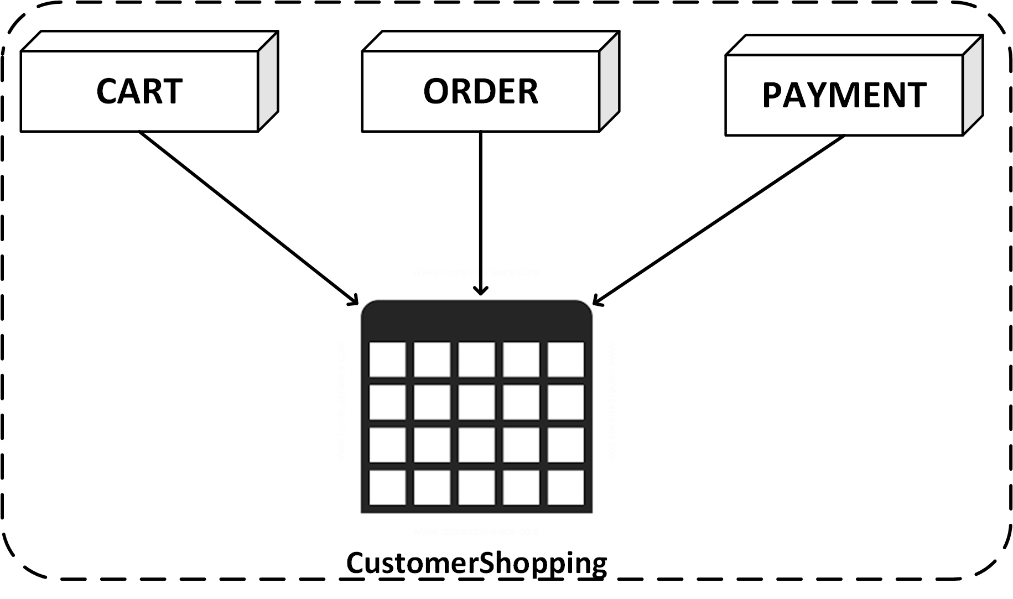
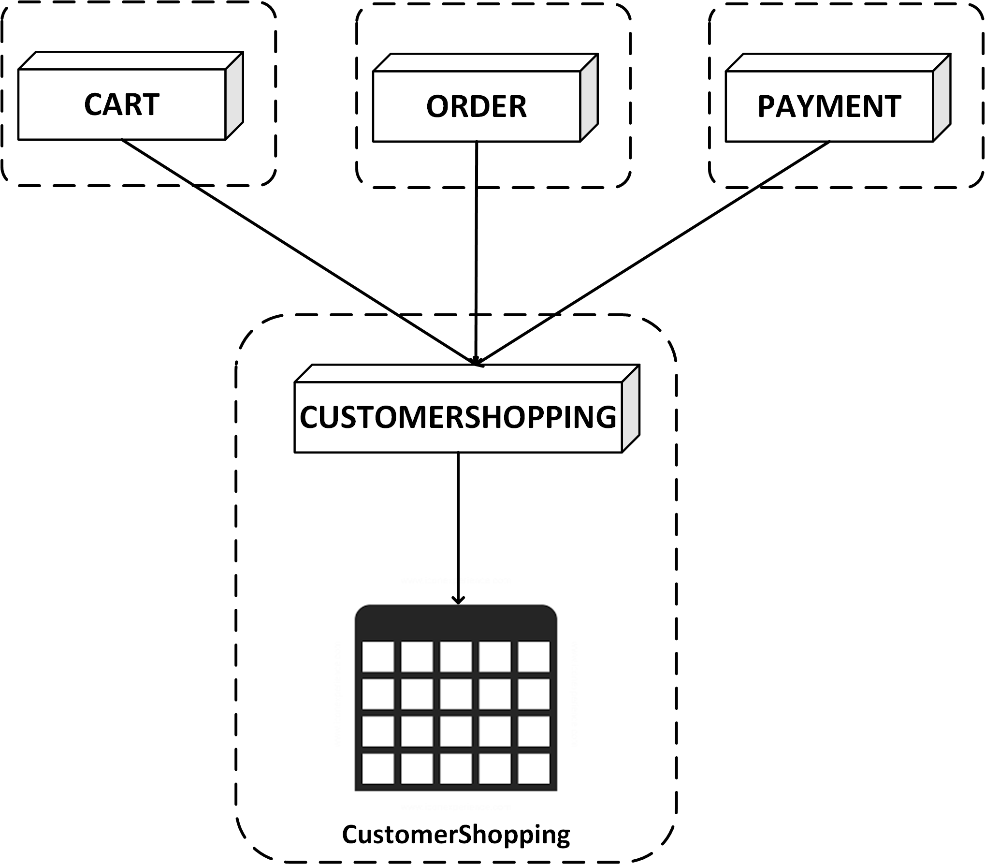
Pattern: Shared Mutable Data
Shared mutable state refers to multiple distinct flows/services that are updating and reading from the same set of tables. This is a pattern in monolithic applications where a single place to update the data for multiple parts of journey is used for convenience.
These patterns represents a lack of domain design where certain domain realities have not been modelled as services, but only modelled in a database, which is accessed alike from multiple services.
Such cases can be hard to find, but should be eventually modelled as a separate service, which provides APIs for other services to work with.

Slide 30
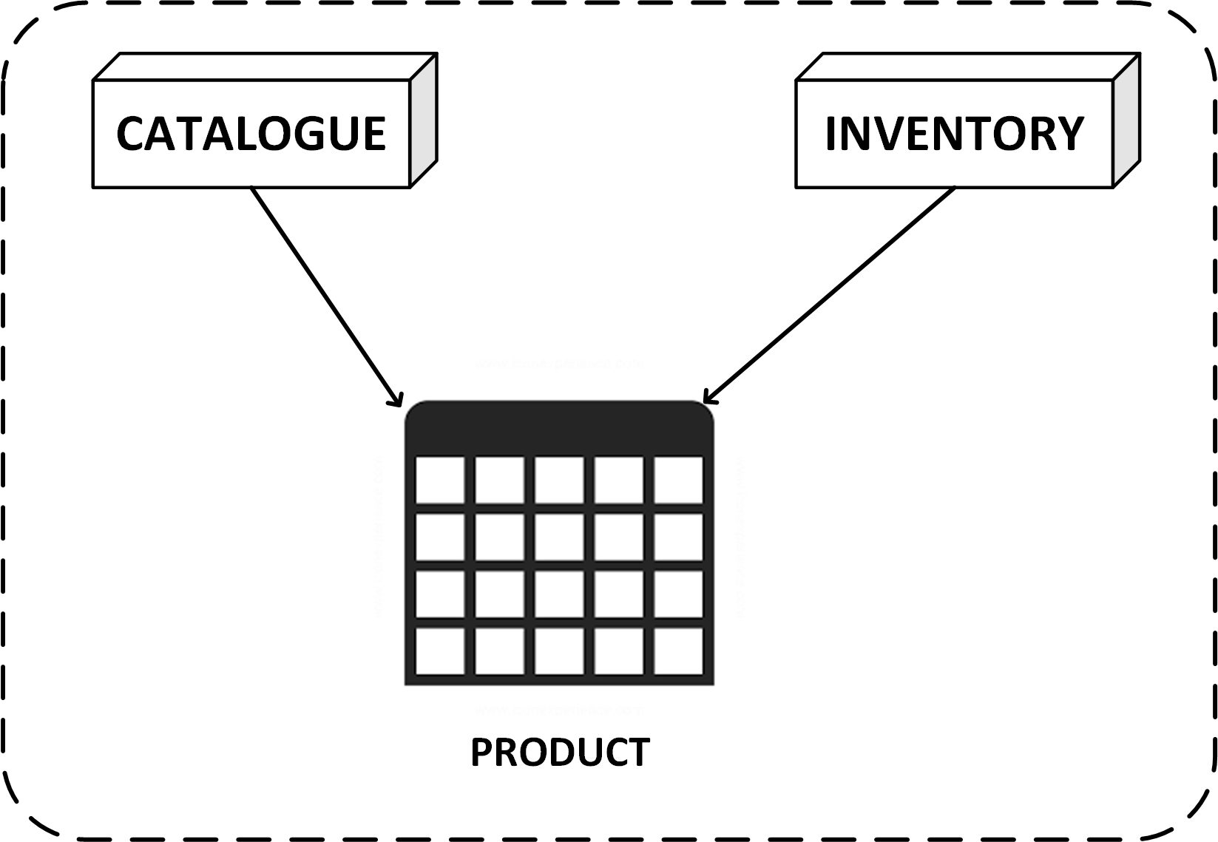
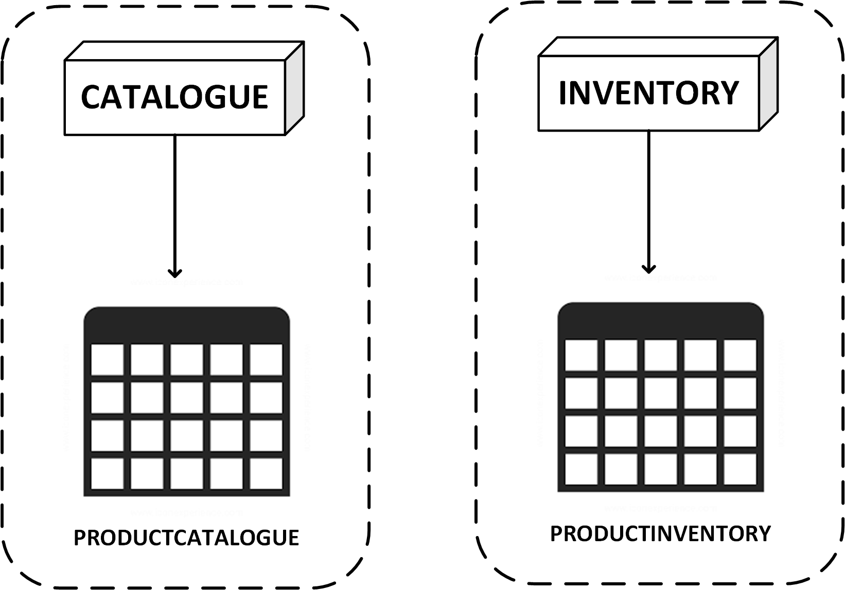
Pattern: Shared Table
Similar to shared mutable state, shared tables present the same issue of domain modelling smell. Same table is used in a broader definition of schema to allow attributes of an entity, which are used in multiple contexts/services. The shared table presents a convenience to fetch from same table (perhaps using a shared utility service) across services.
Shared tables need to be split into individual entities that belong to specific bounded contexts and thus should be modelled separately. This separation follows the separation of the consuming services themselves.

Slide 31
Transactions

Slide 32
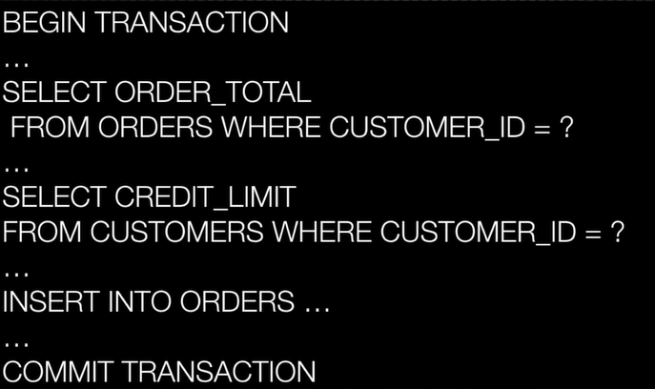
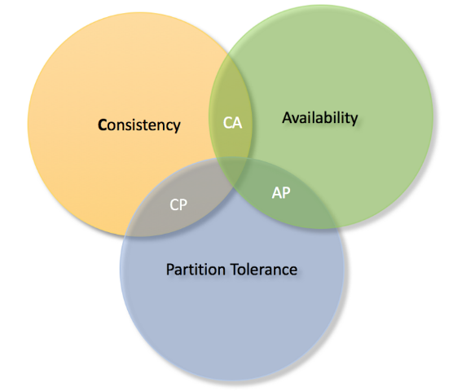
Transaction Boundaries in Microservices
Transactions provide consistency guarantees. The parts of system that are updated under a transaction are left in a consistent state after a transaction completes.
In traditional monolithic systems, since parts of systems are within monolith, it is possible to update them within the scope of the same transaction. For example, to update multiple database tables as part of single transaction initiated by the database driver is a common pattern. [ A C I D ]
Databases schemas and services are isolated in a Microservices. The boundaries of single transactions are thus distributed across many isolated services.
A pattern to handle distributed transaction is 2PC(Two Phase Commit) or XA transaction.
Two phase commit has known issues and in a distributed system doesn’t always provide consistency guarantees. The Transaction Manager can itself fail. Also, central transaction manager means that the individual distributed services have to lock the resources during all phases of 2PC, which leads to contention and thus affect the scalability of system.
So essentially, in a Microservices application, a universal notion of transaction is lost and newer ways to managing transactions, based on “EVENTUAL CONSISTENCY” have to be adopted.
Also, CAP theorem states that in a distributed system, a choice has to be made between consistency and availability.

Slide 33
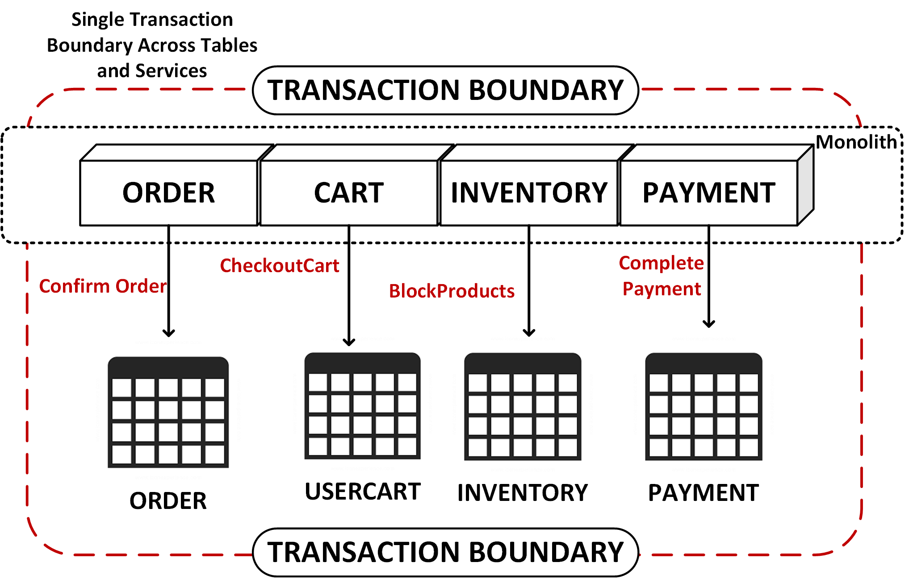
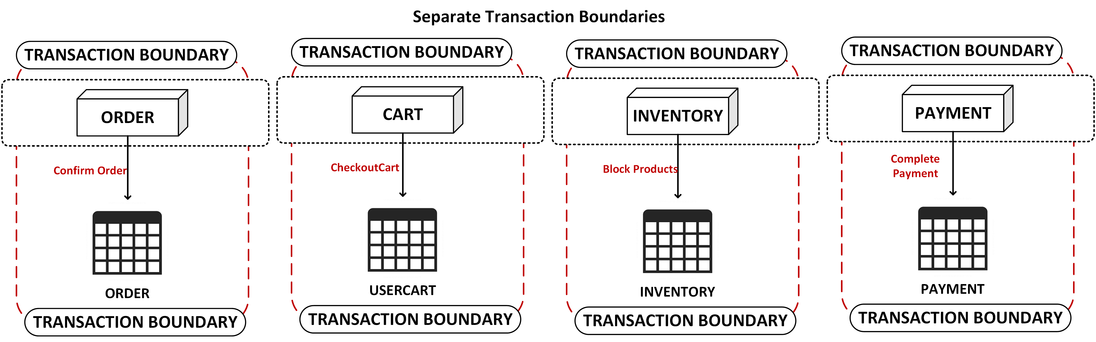
Transaction Boundaries in Microservices (continued)
The transaction boundaries for a single user transaction may be split between multiple Microservices, which need to be invoked or orchestrated in some sequence.
Since the services are distributed over network, the failure on any one service needs to be managed.
Whether the orchestration goes to the “happy path” or encounters failures, the state within the services would be EVENTUALLY CONSISTENT. And thus the user journey should be modelled accordingly (ASYNCHRONOUSLY).
In the most ideal service design, a single Microservice should be AUTONOMOUS enough to complete the entire transaction without depending on other Microservices. But that may not always be the case and the user-transaction needs distributed orchestration.
The transactions within a SINGLE Microservice can be strongly consistent (that is, ACID).
Patterns exist to handle failures in this eventually consistent, distributed services flow.

Slide 34
Transaction Boundaries in Microservices (continued)
OPTION 1: RETRY
OPTION 2: COMPENSATING TRANSACTIONS
OPTION 3: 2PC
If the orchestrator of transaction uses a message bus and the messages for the failed service are queued up, the failure state can be defined for a retry logic.
The retry needs to make sense in case of transaction and would assume that it is okay to accept a delay in submitting the failed transaction later.
The retries can be operational or automated.
If retries is not an option, then the further invocation of the transactions need to be stopped.
Depending on the point of failure, the services that have been invoked would need to “rollback” the previously committed transaction. To enable this, the services would need to provide a “compensating transaction” API (HTTP or Event) to try to undo the transaction and revert back to the old state.
It is possible that the compensating transaction itself fails, in which case, the choices are same as what retry provides, that is, retry automatically or operationally.
This distributed transaction management is encapsulated into a dedicated pattern called as SAGA (and can be choregraphed or orchestrated).
In a monolithic application, if business operations run under a single transaction, consider using a SAGA pattern to model this journey.
Saga patterns works best with async message driven architecture.
Implement global transaction manager and include the Microservices as the resource managers in the global transaction across the Microservices.
It is not a fool-proof method and is difficult to get right in a distributed architecture such as Microservices
Inhibits the scalability of system owing to centralized coordinator and locking needed within services.
BEST AVOIDED

Slide 35
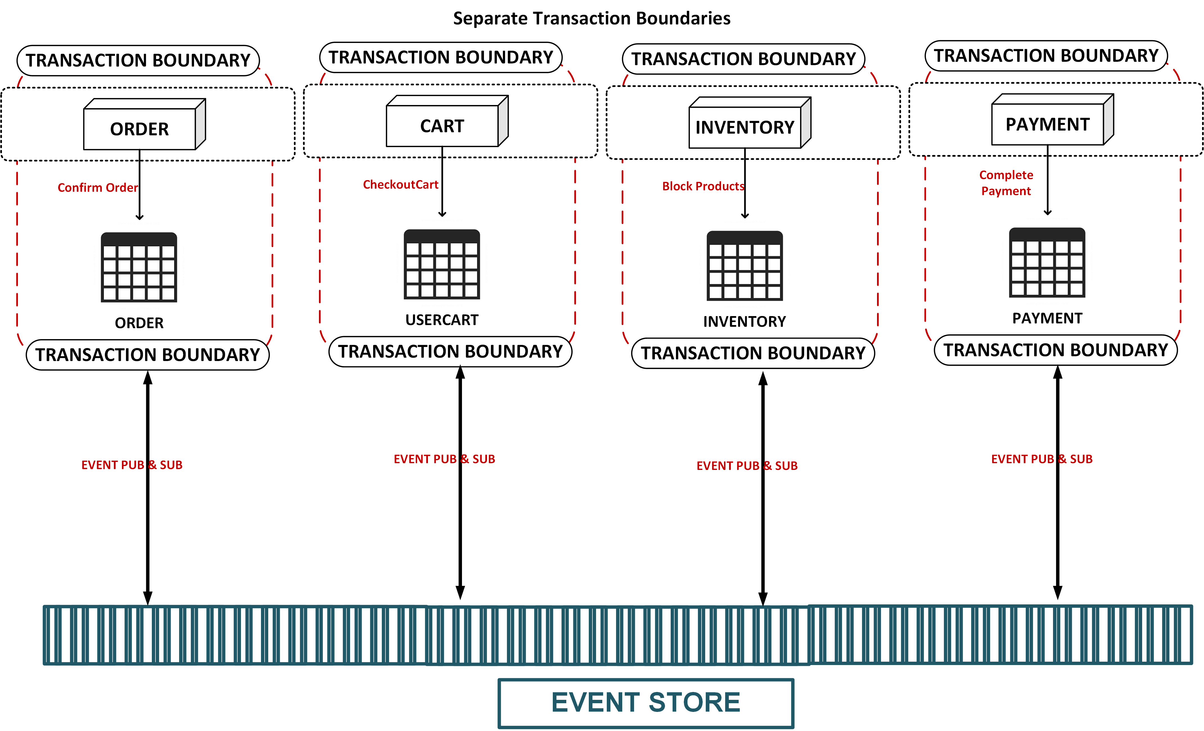
Transaction Boundaries in Microservices (continued)
Async is an event-based approach that provides a realistic way to communicate across transaction boundaries.
It provides failures that could arise out of network failures.
DDD’s domain event pattern is meant precisely for the services between bounded contexts to communicate via async events.
So, there is eventual consistency between bounded contexts while as strong consistency can be provided with the bounded context.

Slide 36
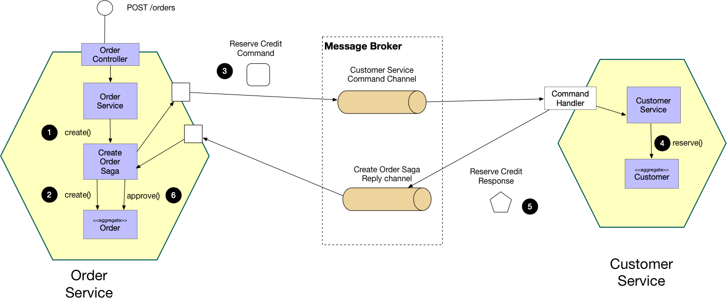
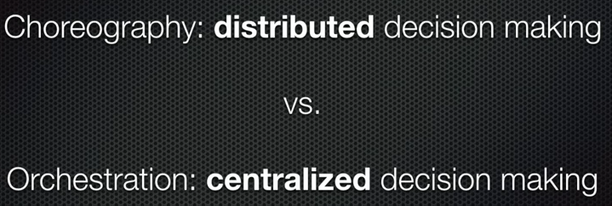
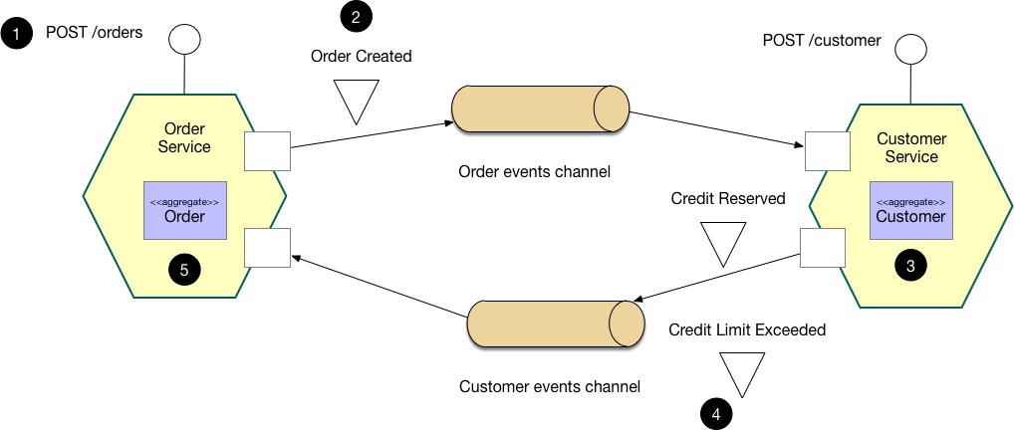
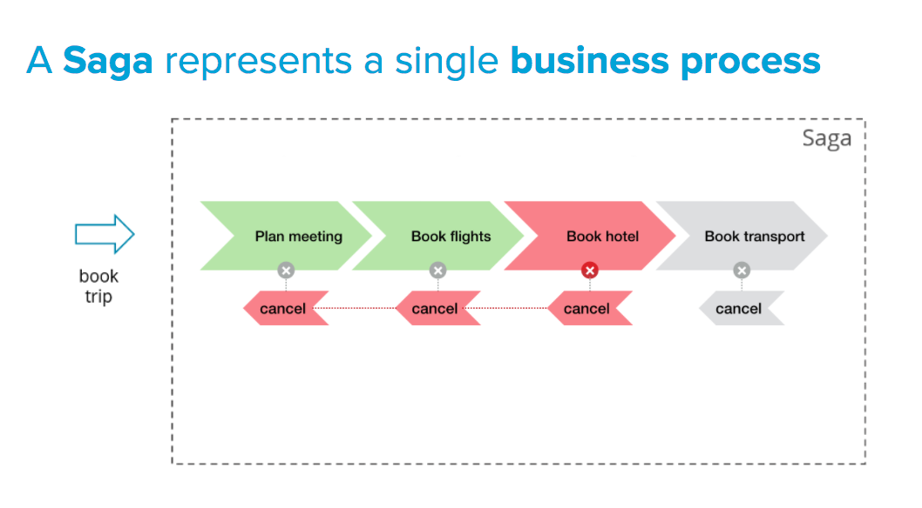
SAGA
Source: https://Microservices.io/patterns/data/saga.html

Slide 37
Reporting

Slide 38
Reporting Across Distributed Microservices
Migrating Monoliths to Microservices
Traditional monoliths rely on the monolithic database as a reporting store.
The reports may be run on a read replica; but, semantically (schema-wise) the reporting database is the same as the online database.
Some instances have batch jobs that Extract, Transform and Load data from online DB and ship it to a warehouse to be used for specialized reporting tools such as Cognos.
In a distributed Microservices architecture, reporting across services is a challenge since each Microservice own its own schema and (as we saw before), the database level relationships for tables across Microservices schemas is broken for Microservices to provide the isolation in Microservices.
There is limited optimization of the data for reporting purposes since it is essentially same as online database, which usually is an RDBMS. The optimization of data for reporting is not based on choice of underlying datastore such as graph, Document, key-value, or column DBs (the NOSQLs).
The data for reporting needs to be brought together somehow to present the reporting system, a system wide view of data and to run the reporting queries.

Slide 39
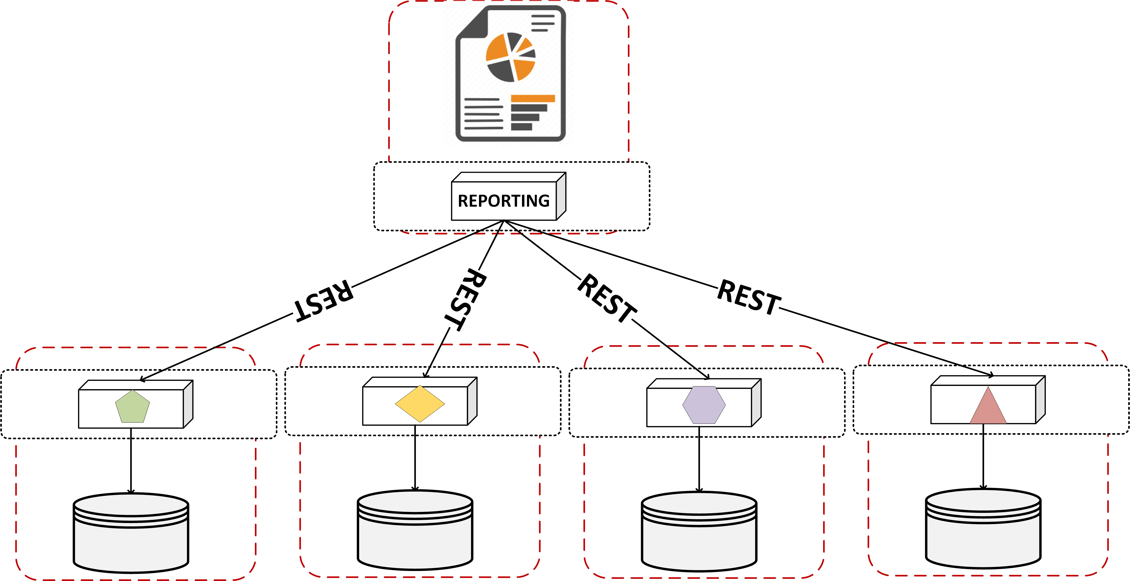
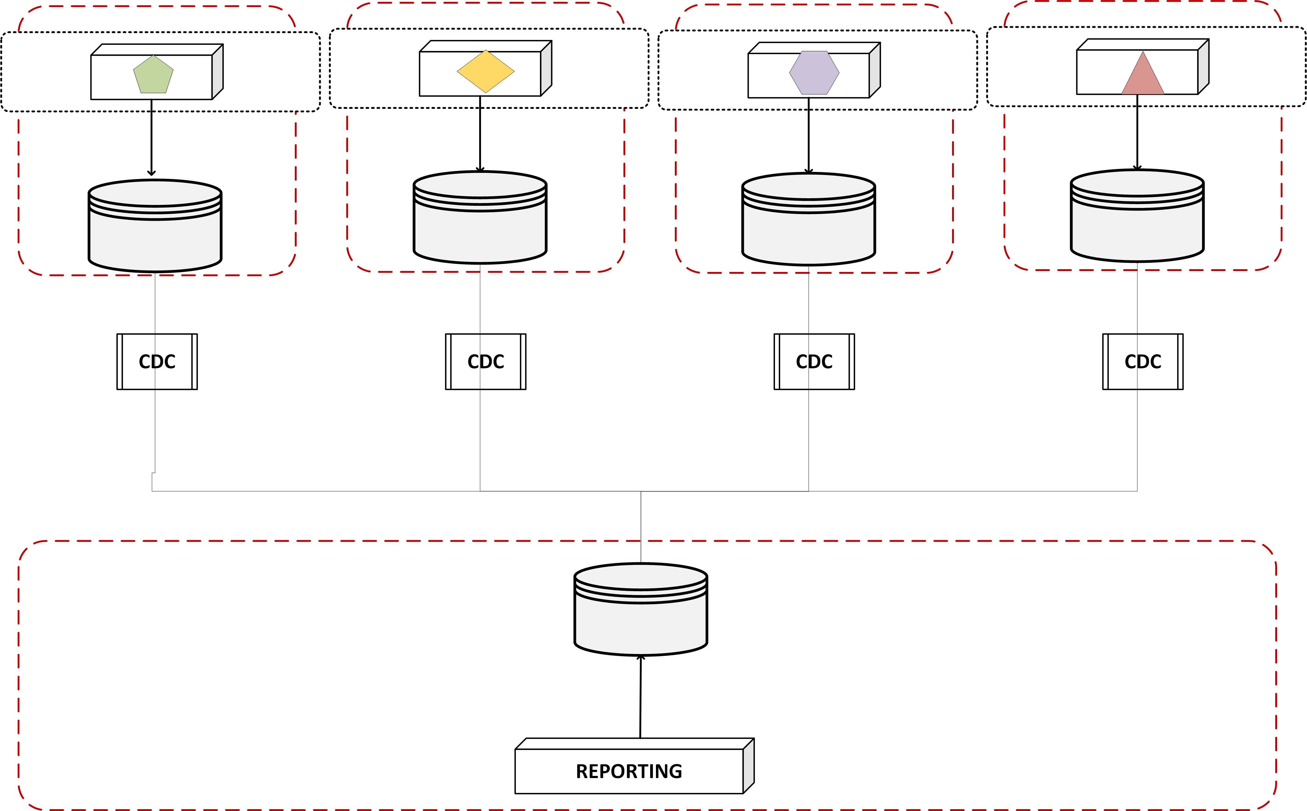
Reporting across Distributed Microservices
OPTION 1 : Aggregate via Service Calls
For simple reporting needs like daily reporting, exposing data APIs from the Microservices which can be accessed by the reporting engine is a simple choice.
The data fetched in this way is consistent and doesn’t need a dedicated component to be in place.
The downside to this is additional responsibility on Microservices to expose APIs that respond with large datasets Or to make the dataset available as an exported file somewhere in file system.
OPTION 2: Data Pumps
The data pumps bring the data from the Microservices schema into reporting schema.
Data pump could be akin to an ETL program, albeit it is much smaller in scope and built and managed by the Microservices team itself.
The pump needs to have transformation logic built in to convert the data from the Microservices schema into the reporting schema.
Each Microservice needs to have a dedicated pump to build and manage.

Slide 40
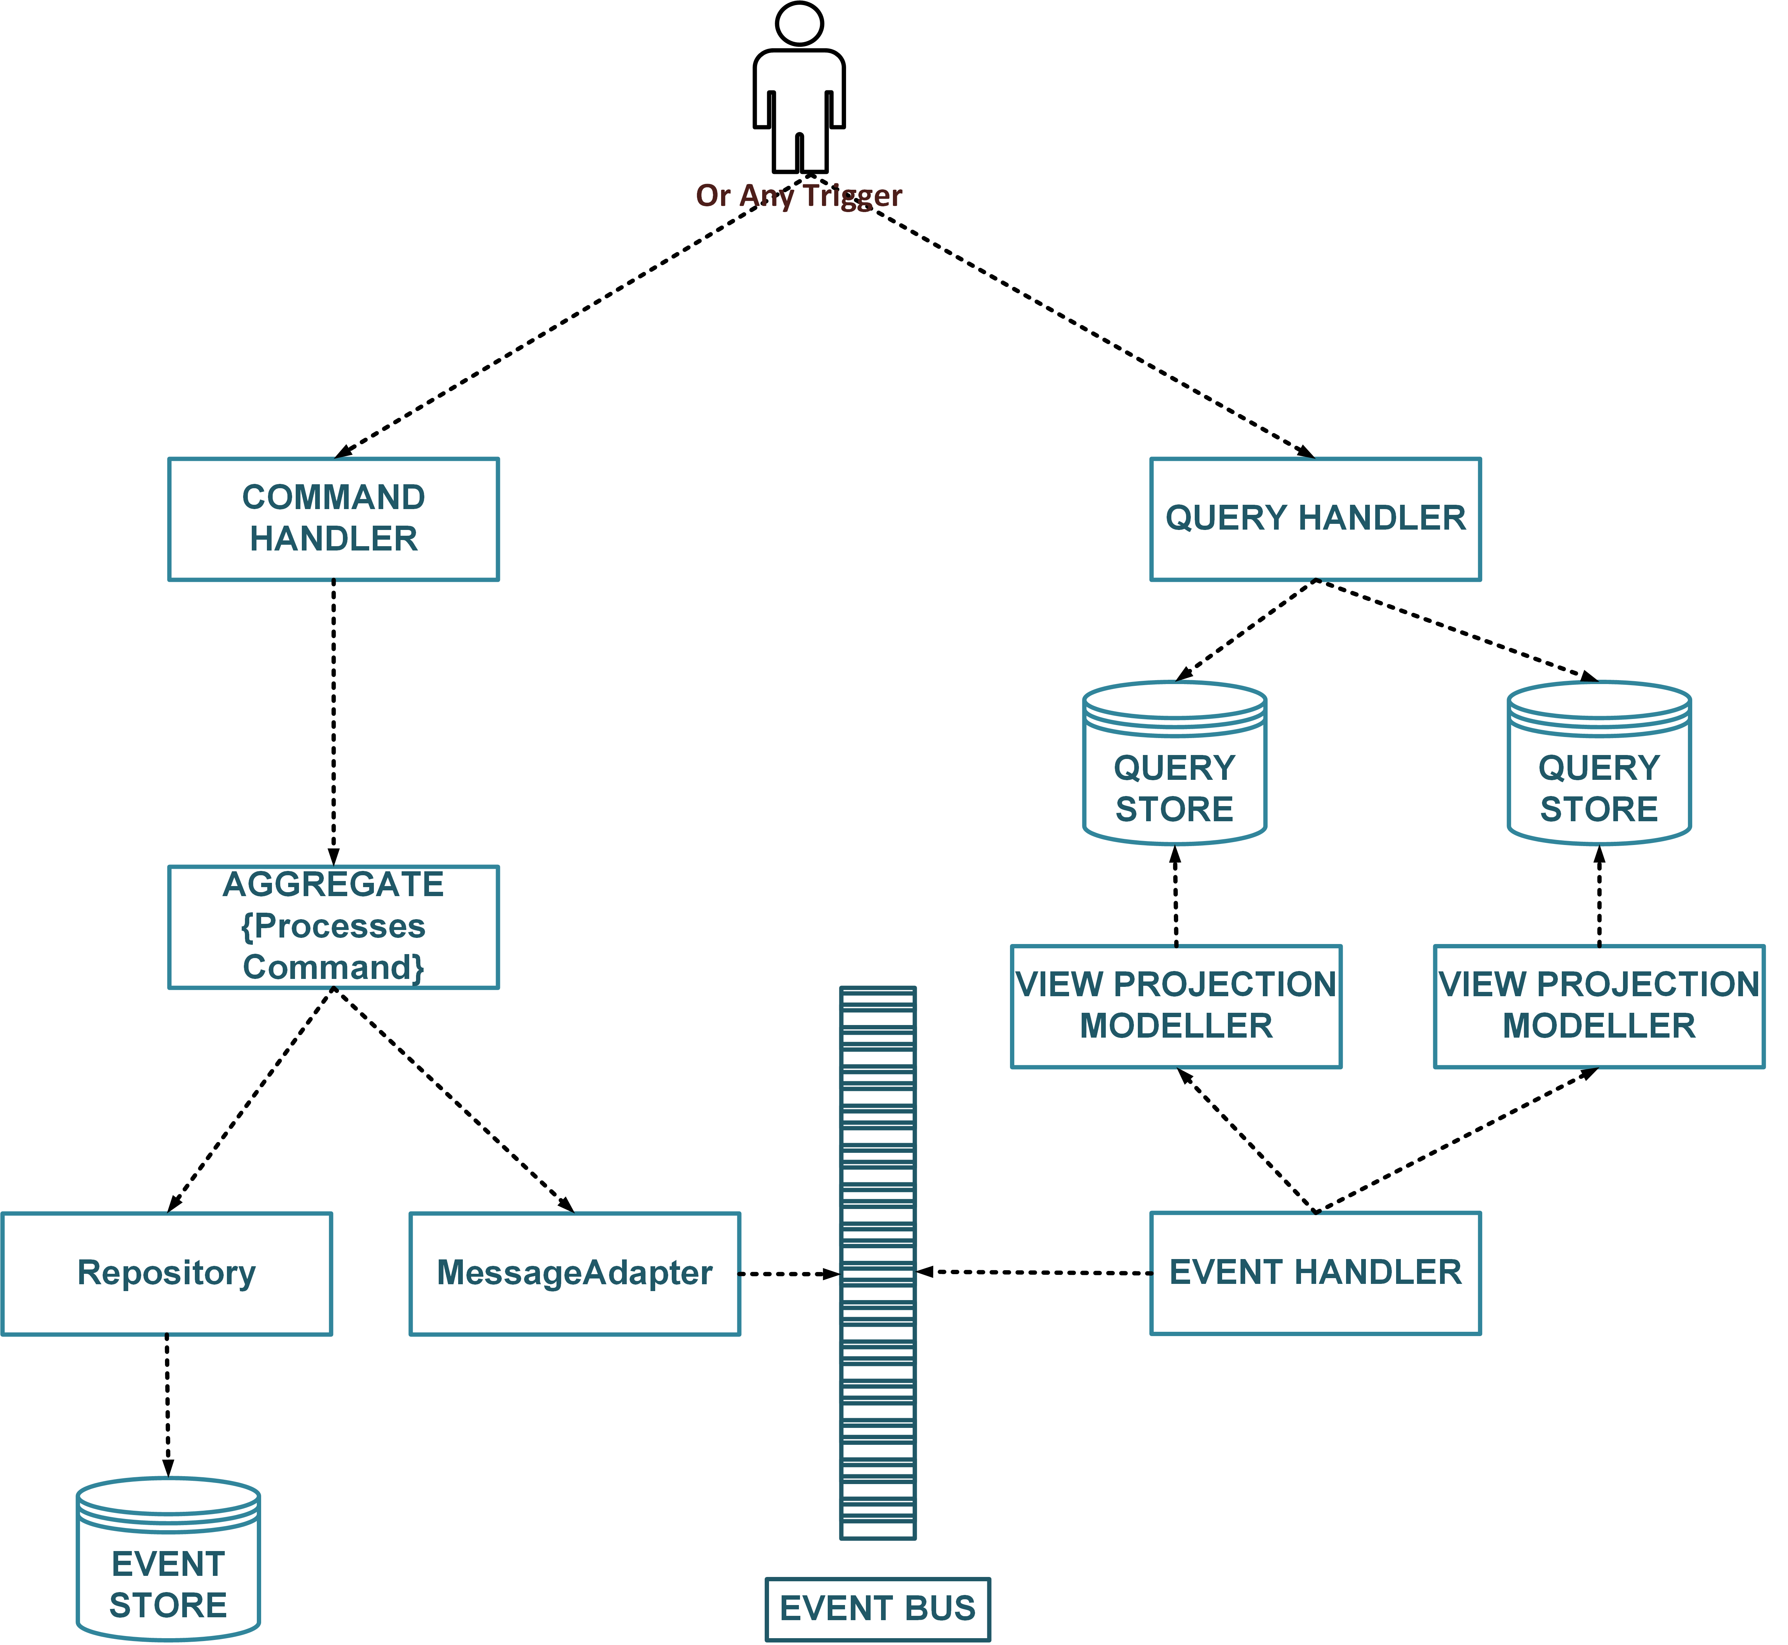
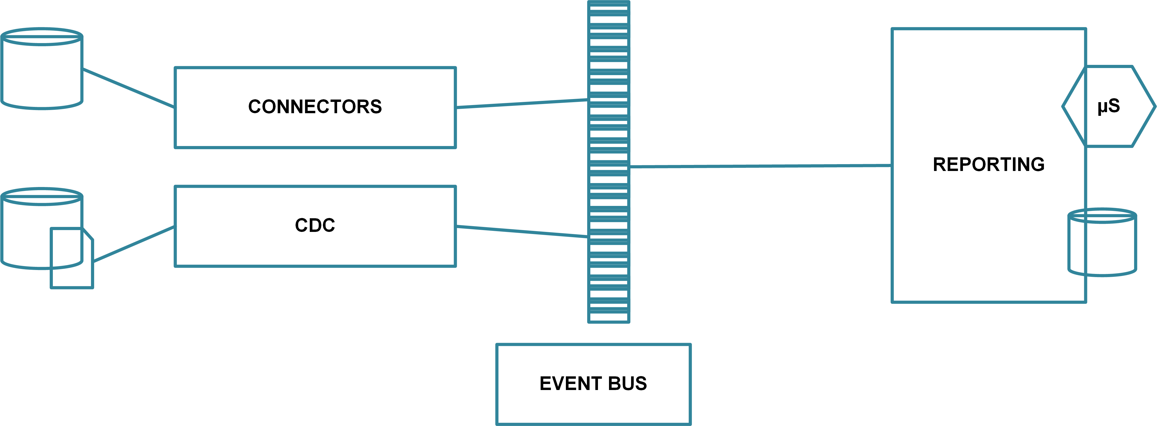
Reporting across Distributed Microservices (continued)
OPTION 3: Event Carried State
Using the event-driven approach the data state “events” can be published to multiple subscribers, reporting system being one of them.
With any of the eventing techniques, the reporting system builds the state of entities and transactions that it needs to report on locally, in the optimized reporting schema or a reporting database.
This technique avoids database coupling or schema mapping.
The state is updated faster than how it would be if data pumps are used.
CQRS pattern is aligned to this option.
OPTION 4: CDC
CDC is a bit of a combination of data pump and eventing. It is specifically used in the modern architecture to include some kind of streaming platform that has a source and sink of data.
Change Data Capture relies in specialized solutions that listen to a database change/redo/transaction logs and stream any change as event in the streaming platform, such as, Kafka Topic, which in turn is listened to by a reporting DB which that builds its state.

Slide 41
UI – ‘FrontEnd’

Slide 42
Decomposing Frontend Monolith
Migrating Monoliths to Microservices
The applicability of Microservices as isolation of boundaries across sub-domains is easy to see in the business services that provide the processing workloads for a user journey. The big leverages that this architecture provides is: Independent Delivery and Release, Autonomous Cross Functional and Focussed Teams, and overall services isolation in Time and Space.
Microfrontends is the logical application of this architecture to the front-end layer, that is, using the domain and service boundaries in front-end, so that a business functionality is completely and truly autonomous across all layers and can leverage independent delivery, single team ownership, and autonomy of design decisions within the team across all layers. Teams that are organized around business services get to own the service end2end across all layers.
The idea of Microfrontends is to think about the WebApp as a composition of UIs which are owned by independent teams that deal with specialized area of business. The team focusses on delivering the UI for the service it owns, so in effect created a focussed part of the entire front-end, a micro-frontend.
The team thus owns the UI, Microservices, and Data layers end-to-end. Microfrontends are the Microservices akin that view UI tier and a composable structure instead of one big monolith.

Slide 43
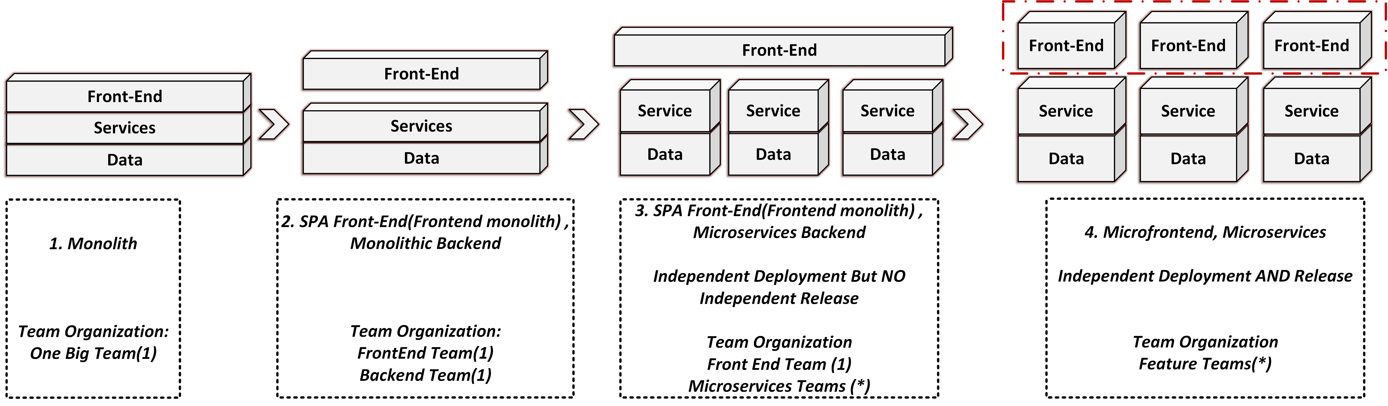
Decomposing Frontend Monolith: Journey
Migrating Monoliths to Microservices

Slide 44
Decomposing Frontend Monolith
Migrating Monoliths to Microservices
The UI tier in the monoliths can be of varying kinds, so there is no standard starting point for the migration from the ‘monolithic frontends’.
The end target for this migration is to allow the service teams to produce the UI for the services and provide a platform to aggregate these UIs (MicroFrontEnds) into a cohesive application UI.
The aggregation technologies have been in use before as well in the form of Server Side Includes or Portlets.
On the other side, Single Page Applications enable this aggregation on the browser.
Depending on the layer of aggregation and point of aggregation, different options are possible.
This mobile native applications are usually built as single cohesive app, backed up by Microservices data APIs.

Slide 45
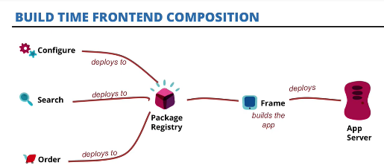
Build Time: FRONT END
Migrating Monoliths to Microservices
Source: : https://www.slideshare.net/ThoughtWorks/building-application-in-a-microfrontends-way-matthias-lauf-xconf-manchester

Slide 46
Build Time: SERVER END
Migrating Monoliths to Microservices
Server-Side Build time composition is a traditional monolithic technique that uses the design time to compose and compile a page using servlet (JSP) or a portlet.

Slide 47
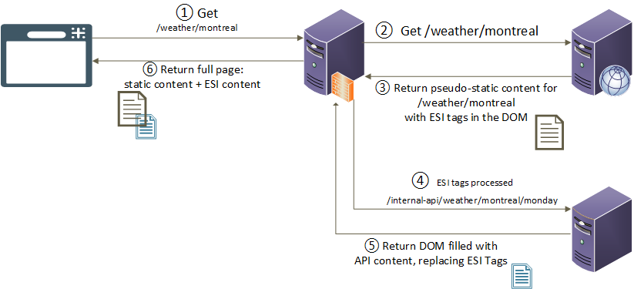
Run Time: SERVER END
Migrating Monoliths to Microservices
References:
https://en.wikipedia.org/wiki/Edge_Side_Includes
https://github.com/Schibsted-Tech-Polska/nodesi
https://github.com/tes/compoxure
https://github.com/zalando/tailor
Source: https://www.gosecure.net/blog/2018/04/03/beyond-xss-edge-side-include-injection

Slide 48
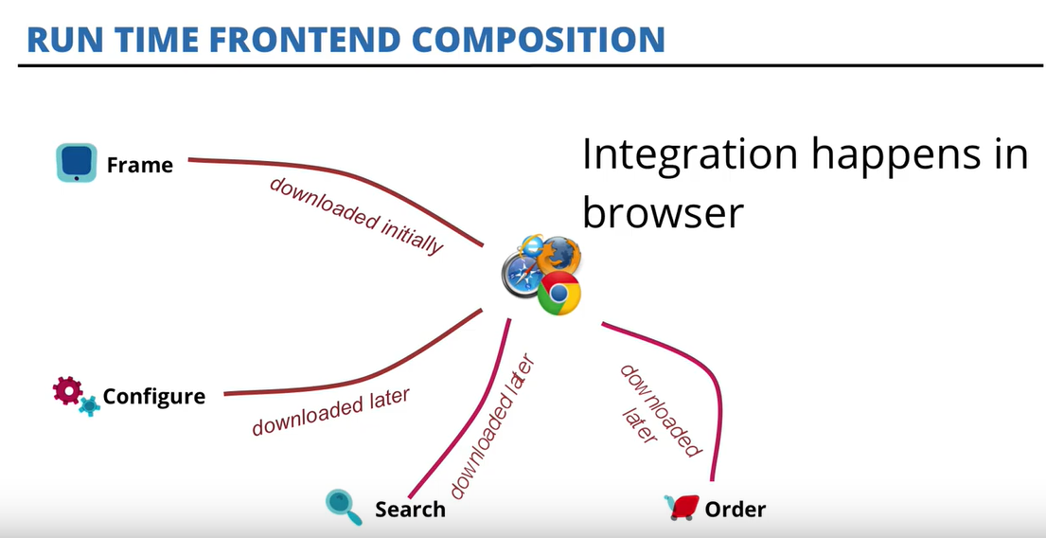
Run Time: FRONT END
Migrating Monoliths to Microservices
Source: https://www.slideshare.net/ThoughtWorks/building-application-in-a-microfrontends-way-matthias-lauf-xconf-manchester

Slide 49
Decomposing Frontend Monolith
Migrating Monoliths to Microservices
Server-Side Build time composition is a traditional monolithic technique that uses the design time to compose and compile a page using servlet (JSP) or a portlet.
The choice of micro-frontend design needs to be a shared understanding across teams.
The polyglot promise of backend Microservices technically should be available in the MicroFrontEnds also. However, it needs careful analysis since the coupling of MicroFrontEnds in a single browser is stronger than API based coupling between backend Microservices, for example, MicroFrontEnds at least share the same browser/native runtime kernel, which is not the case with backend Microservices. On the other hand, introducing same UI composition framework introduces coupling and any upgrade impacts all the MicroFrontEnds in that case. So, there is a bit of investment needed in balancing the polyglotism in MicroFrontEnds.
Custom-Elements aims to provide interoperability (based on webcomponents specification).
Check that out!

Slide 50
Event-driven Patterns

Slide 51
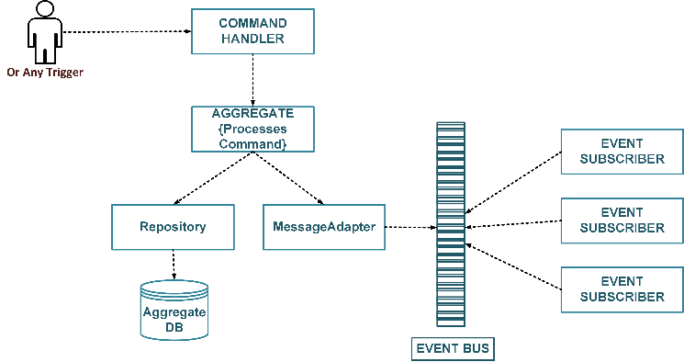
Event Notification
Migrating Monoliths to Microservices
System sends event message to notify other systems of a fact in domain, without making any assertions as to how the event would be processed.
Thus, notification carries state of fact already happened.

Slide 52
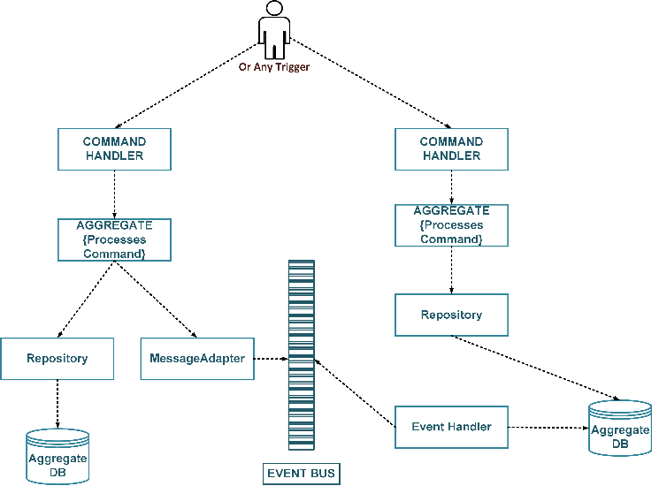
Event Notification (continued)
Migrating Monoliths to Microservices
Microservices own their state in their isolated data store, which is not shared with any other Microservice directly and is accessible only over an API. There are use-cases where the data from a Microservices need to be used in real-time by another Microservice, but making network calls to the API of the owning Microservice is not an option.
Instead, the owning Microservice publishes the state change events that the interested Microservice can consume and maintain their own read-only set of the same data. When needed, this local copy of data is used to optimally query and compose the response.

Slide 53
Event Notification (continued)
Migrating Monoliths to Microservices
It is a design technique where the state of a sub-domain is stored as a set of events in an event-store, without maintaining a current state.
Traditional state-based persistence fails to capture the intent and loses the ability to know how current state has come about.
In ES, current state is always derived from the events from event-store. At any point, state of the system can be built by running the events in sequence.
ES eliminates needs for Update and Delete from CRUD.

Slide 54
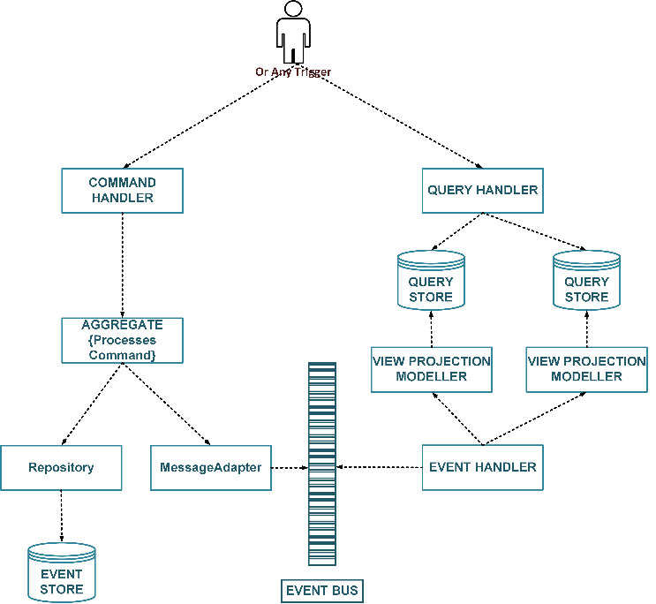
CQRS
Command component, where the state changes and processing happen, just need to send the results out as events to one or more query processors, which are optimized for view and search querying model.
When used with ES, it solves the problem of having to query the event-store or multiple event-store to answer a query. Events are inefficient to query, since all of the events would have to be replayed to build aggregate states and then search among them; and more so of queries that are spanned across multiple aggregates.
As a design concept, Command Query Responsibility Segregation doesn’t rely on events, but it is commonly combined with event driven techniques since separating command and query design and stores fits ideally in an event driven model. It simply acknowledges the fact that write models may be inefficient as read models and thus should be managed separately, even using different types of databases.
(https://martinfowler.com/bliki/PolyglotPersistence.html)
Even without ES, it is inefficient to use aggregate root as starting point to answer queries.

Slide 55

Q&A

Slide 56

Summary
Summary
You have completed the Migrating Monoliths to Microservices module. You should now be able to:
Understand the various situations that lead to the transition from Monoliths to Microservices
Recognize the factors that lead to service decomposition
Identify the criteria involved to tackle the database while transitioning to Microservices
Understand the transactions, reporting practices, UI, and event-driven patterns that are involved in the transition

